Slide 1

YOUR CBI MEMBERSHIP
  March 2024

Slide 2
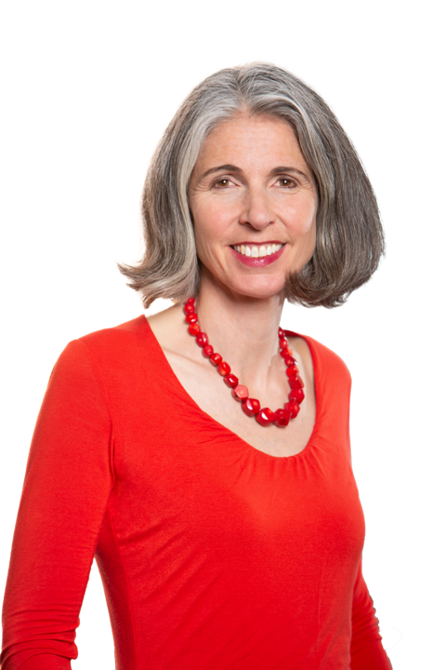
We are the collective voice of business
      In the run-up to a critical General Election, a strong business voice is vital. That’s why we’re here, to lift up your voice, share your views with political decision-makers at every level, and work with you to help shape the UK’s future.
      Together, we face serious economic and social challenges, from a cost-of-living crisis to climate change. But together, we can ensure sustainable growth for the benefit of all, by supporting your firms to do what they do best – creating good jobs and opportunities. Representing businesses of all sizes and sectors across the whole economy, and our regions and nations, the CBI is committed to tackling the issues you face, and pushing for action that enables you – and the UK – to thrive.
      And you’ve told us where that action, and our focus, is needed most. So, we’ll continue to collaborate with our members, political stakeholders and partners to equip the UK to lead the race to net zero and compete globally, as well as help you develop and invest in people and talent in the UK, adopting the latest innovations and new ideas. We want your input at every stage to best represent the priorities of businesses across the length and breadth of the UK and internationally.
      Through influence, insight, and detailed economic analysis, the CBI is uniquely placed to support and represent you, and to ensure your voice is heard on issues of national importance.
      We look forward to working with you to deliver ambitious, positive change and sustainable growth.
    Rain Newton-Smith
    Chief Executive, CBI

Slide 3

We speak up for your business
      There's no organisation quite like the CBI. We are the strong, collective voice that enables all businesses to propel positive change and sustainable growth.
We speak on behalf of
170,000
business of all sizes and sectors, across
every region and nation of the UK
This includes over
1,100
corporate members
& nearly
150
trade associations
Our corporate members alone employ over
2.3million
private sector workers

Slide 4
Unlock the true value of
your membership
    Use this resource to understand our key areas of focus and the opportunities that are available for your business to get every last drop of value out of your membership.
    Whether that’s by shaping our policy recommendations, attending a Working Group or Committee, or by networking with your peers at one of our industry-defining events, we want to know about your business’ priorities, challenges and successes.
Our purpose: To be the collective voice of business, achieving sustainable growth.
Our mission: To be the catalyst between industry and government, driving positive change. To speak for businesses of all sizes and sectors across the whole economy, in every UK region and nation, ensuring sustainable growth for the benefit of society.

Slide 5


Get your voice heard in your region and nation, and on the world stage
      We’ll support you wherever you are in the UK. CBI membership gives you a joined-up offer – from macro to micro and from international to regional – so we can support you in a way that no others can.
    Help shape policy in your region or nation
      Through our great working relationships with devolved governments, local authorities and Metro Mayors, you’ll be able to get your voice heard in your local area. We’ll work together to get the outcomes you need so your business can thrive.
    Influence your operating environment beyond the UK
      But it’s not just in the UK that we’ll drive the change your business needs to see. Through our international networks and presence in Brussels, you’ll be able to influence your broader operating environment:
          Help shape the UK’s response to global issues like trade and investment,
          decarbonisation and taxation
          Join exclusive OECD committees and working groups to influence their work
          through the CBI’s membership of Business at the OECD
          Help the CBI improve the UK-EU Trade and Co-operation Agreement
          through the CBI’s role as Chair of the UK Domestic Advisory Group.

Slide 6
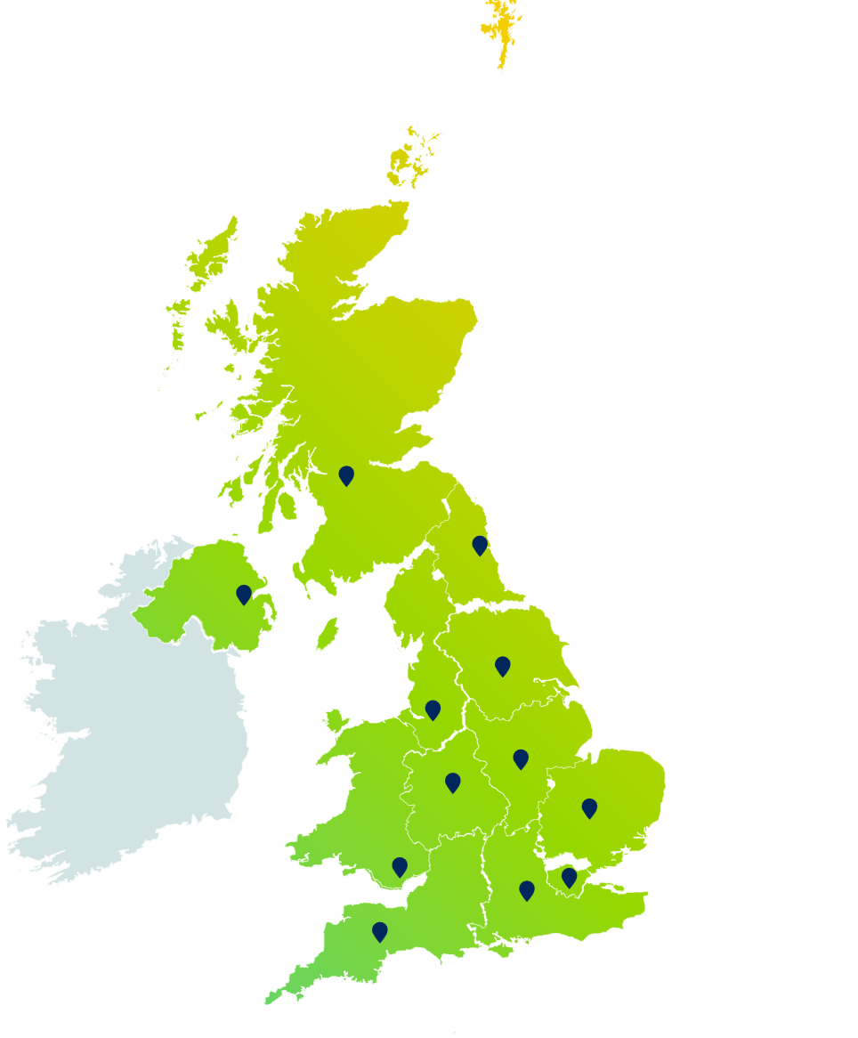
In every region and
nation in the UK
    Click on your area to be directed to your local contact:
Scotland
North East
Northern Ireland
Yorkshire and the Humber
North West
East Midlands
West Midlands
East of England
Wales
London
South East
South West

Slide 7

Our key wins for 2023
    Securing permanent full expensing
        Our campaigning resulted in full expensing – which allows companies to deduct 100% of qualifying plant and machinery costs from taxable profits – being made permanent. The Office for Budget Responsibility expects this will boost UK investment by £13.9bn in real terms by 2028/29.
    Increasing funding for existing childcare provision
        After the CBI lobbied government to reduce spiralling childcare costs, the government confirmed that it would increase funding for existing childcare provision.
    Supporting grid connectivity
        We asked the Chancellor to cut the time it takes to build electricity transmission infrastructure and obtain connections to the grid. In the Autumn Statement, the Chancellor announced a reform of the grid connection process to cut waiting times.
    Creating a new, simplified R&D tax credit scheme
        The CBI pushed the Chancellor to introduce a new R&D tax credit scheme that would be simple, certain and would drive investment from innovative businesses of all sizes. The Autumn Statement in November 2023 laid out a new, simplified R&D scheme.
    Pushing the government to join Horizon Europe
        In March, the CBI, along with representatives of the UK and wider European research, innovation and business communities, signed a joint statement pushing for finalisation of the UK’s association to Horizon Europe. And in September 2023, the UK joined Horizon Europe under a bespoke deal.
      See all our wins from 2023

Slide 8



Influence
    Shape the business environment to work for you.
      The CBI regularly meets with the most senior politicians and government officials to share evidence and sentiment from the business community. This gives you a direct line to share your views and steer policy, legislation and spending decisions in the areas that matter most to your business.
      With our large team of policy experts and economists, together with our fully costed policy solutions, you’ll have all the support you need. For example, join a CBI Council and help steer CBI policy in the areas that are most important to you. Or become a leading voice on net zero, the future of work, UK competitiveness and more.
Insight
    Plan with confidence and mitigate risk to your business through practical guidance and evidence-led analysis.
      Membership gives you exclusive access to practical guidance that supports and empowers your business. For example, get the insight you need to make better decisions with our UK Economic Forecast, or need-to-know political intelligence and analysis for key moments like the Annual Budget.
Community
    Give your team direct access to
    cross-sector peer networks and
    topic-specific communities.
      Attend a variety of conferences, roundtables, working groups and digital events. Our events convene business leaders, subject matter experts and government representatives to give you insight, advice and inspiration. But you’ll also be able to raise your own profile with ample opportunities to showcase your expertise on the areas you are making a difference in.
      For example, attend one of the CBI’s Government Affairs Network events, or join our Sustainability Community to network with and learn from peers taking their business on a net zero journey.

Slide 9

What does membership look like?
      Membership is for your entire senior team. Contact your Account Manager to add your colleagues to your membership so your organisation feels the full benefit.
    Government Affairs
          Have direct policy influence
          Connect with our campaigning experts
          Get the latest political insight
    Sales and Marketing
          Reach new audiences
          Profile your business
          Get UK and international business intelligence
    CEOs and Business Owners
          Build your network
          Raise your profile
          Get strategic support and market intelligence
    Products, Tech and R&D
          Understand emerging tech
          Increase your productivity and R&D capacity
          Find new innovation partners
    People and HR
          Shape new employment legislation
          Explore ways to attract and develop talent
          Learn from others on best practice
    Finance and Corporate Governance
          Get the latest economic intelligence
          Tackle the rising costs of tax and regulation
          Understand changes to UK corporate governance

Slide 10
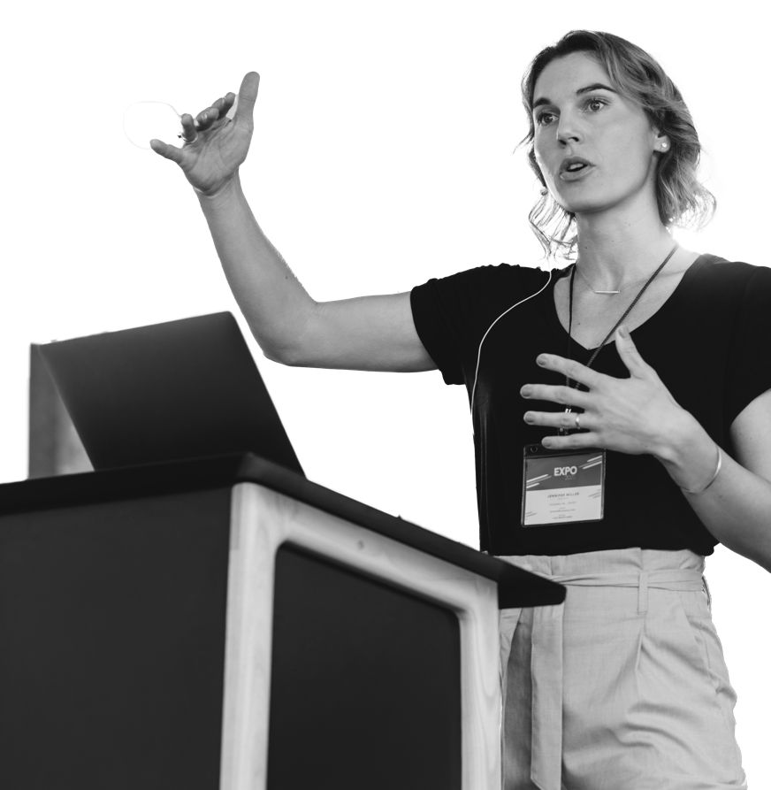
Learn, connect and be inspired
  Supercharge your membership with a CBI event.
      What are you waiting for?
      Are you looking for new ideas to help solve your business challenges? Do you want to meet some of the most influential figures in British business and politics? At the CBI, we host regular best-in-class events all year round, both nationally and in all regions around the UK. By attending a CBI event, you’ll come away brimming with new ideas and connections you can start using right away.
    National events
    Our national events connect you with the great and the good of UK business and provide unique opportunities to hear from leading UK politicians on the issues that matter.
    Events where you are
    Wherever you are in the UK, there are unmissable CBI events waiting for you. Every region has a unique offer that will be a blend of peer networks, high-level networking events and member briefings.
          Peer Networks: Our Peer Networks, like our Finance Directors Network, People and Skills Network or our Future Leaders Network, encourage the sharing of brilliant ideas, best practice and learning from others
          Regional lunches, dinners, and receptions: Join us at one of our high-level networking events, bringing together the best in business in your region. Catch up with fellow business leaders and colleagues or build more valuable connections with your clients.
          Member briefings: Join a small group of senior business leaders in your area to get the latest insight and intelligence from the CBI on a wide range of political, economic and policy topics. It’s also a fantastic opportunity to network with other businesses, and get your voice heard on the key issues of the day.
      Register for one of our events

Slide 11

Policy activity led by our Members
      Throughout May 2023, we convened over 1,000 business leaders from member companies, to identify where they wanted the CBI to focus its policy development and influence. We also received 269 survey responses. From these conversations, the most critical economic and national issues you identified were:
          The future of work and skills
          Establishing the UK as a leading, internationally competitive location for business
          Tackling climate challenges and the energy transition.
      Driven by those key issues, we have developed ambitions for the UK economy and pledges for how business, in partnership with government, can achieve those ambitions. Our policy priorities, driven by our members, are rooted in real business need and, if realised, would turbocharge the UK economy in service of sustainable growth.

Slide 12




Overview of the updated CBI policy programme
CBI Key pillars and workstreams
Net Zero
Future of Work
Technology & Innovation
UK Competitiveness
Ambition
Ambition
Ambition
Ambition
Helping the UK to lead the global race to net zero while managing the transition of the economy.
Working with members to respond to the changing nature of the future of work and skills.
Supporting members to manage the transformation that is being driven by technology and innovation.
Working on how to equip the UK – its nations and regions - on how to ensure we have a globally competitive business environment.

Slide 13


Public affairs
    The ambition
      To ensure the CBI is the 'go to' UK business organisation for insight, evidence and ideas, which we provide in collaboration with you, our members.
    Our pledges
          To maintain consistent engagement with key political stakeholders
          To provide members with political engagement opportunities
          To enable sharing of political insight.
          What we’ve done
          We’ve maintained consistent engagement with key political stakeholders, including with no10, Chancellor Jeremy Hunt, Labour leader Keir Starmer, Shadow Chancellor Rachel Reeves, and many more
          We’ve provided members with political engagement opportunities, including member roundtables with Gareth Davies, Permanent Secretary at the Department for Business and Trade, and Shadow Net Zero Secretary, Ed Miliband.
          What we’ll do
          We’ll continue to engage with key political stakeholders, including the Chancellor, Shadow Chancellor, and more
          We’ll continue to provide members with engagement opportunities, including with Darren Jones MP, James Murray MP, Rushanara Ali MP, Liam Byrne MP, and more.
        Are you interested in feeding into our policy submissions ahead of key fiscal moments? Would you like to find out more about current and upcoming Public Affairs opportunities, meetings or events? Reach out to Alice Grimes, Head of Public Affairs.

Slide 14


Net zero
    The ambition
      For businesses to lead a successful transition to net zero in the UK, with a world-leading environment for the growth in green industries, maximising the investment opportunities associated with the change.
    Our pledges
          To speed up net zero infrastructure delivery
          To strengthen green investment incentives
          To deliver competitive energy costs
          To demonstrate net zero international leadership.
    What we’ve done
          We’ve responded to the Autumn Statement and published net zero investment and delivery policy recommendations in the CBI business manifesto
          We persuaded the Chancellor to cut the time it takes to build electricity transmission infrastructure and obtain connections to the grid.
    What we’ll do
          We’ll deepen engagement with the Shadow Ministerial team to influence Labour’s prioritisation of green investment to drive UK growth
          We’ll convene members on the government’s response to addressing carbon leakage risk to support decarbonisation and the future of the UK Emissions Trading Scheme.
        If you’d like to hear about current and upcoming opportunities in Net Zero, please contact Tania Kumar, Policy Director, Net Zero.

Slide 15


Future of work and skills
    The ambition
      For UK business to successfully navigate a future of work in which technology is rapidly changing the skills needed by businesses, and the employee and societal expectations of employers are increasing.
    Our pledges
          To sharpen focus on adult skills
          To reduce shortages by tackling barriers to work.
    What we’ve done
          We persuaded the government to increase funding for existing childcare provision
          We’ve submitted via the CBI’s Business Manifesto key recommendations for the next government to take to improve adult skills and tackle labour shortages
          Following CBI lobbying earlier in the year, the Treasury launched a public consultation on the tax treatment of employee health interventions and occupational health provision.
    What we’ll do
          We’ve launched a new Education & Skills Working Group, and an exclusive member roundtable on adult skills
          We’re launching a new labour shortages campaign targeting political stakeholders and members suffering from their impact.
        To get involved with Future of Work, including anything labour or skills related, please reach out to Matthew Percival, Future of Work and Skills Director, to find out about upcoming opportunities in this area.

Slide 16


Technology and innovation
    The ambition
      For the UK to be the best place in the world for businesses to invest in and benefit from innovation and technology, and to grow an innovative business.
    Our pledges
          Technology adoption for productivity
          Innovation-enabling regulation
          Science and technology superpower
          Scaling an innovative business.
    What we’ve done
          We persuaded the Chancellor to introduce a new R&D tax credit scheme that will be simpler, certain and will drive investment from innovative businesses of all sizes
          We persuaded the government to rejoin Horizon Europe on a bespoke deal.
    What we’ll do
          We’ll follow up on the government’s response to the AI White Paper consultation
          We’ll host member roundtables on topics including innovation regulation and technology adoption.
        To find out about current and upcoming opportunities, meetings and events in Technology and Innovation, please contact Benjamin Reid, Technology and Innovation Transformation Director.

Slide 17


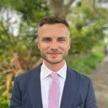

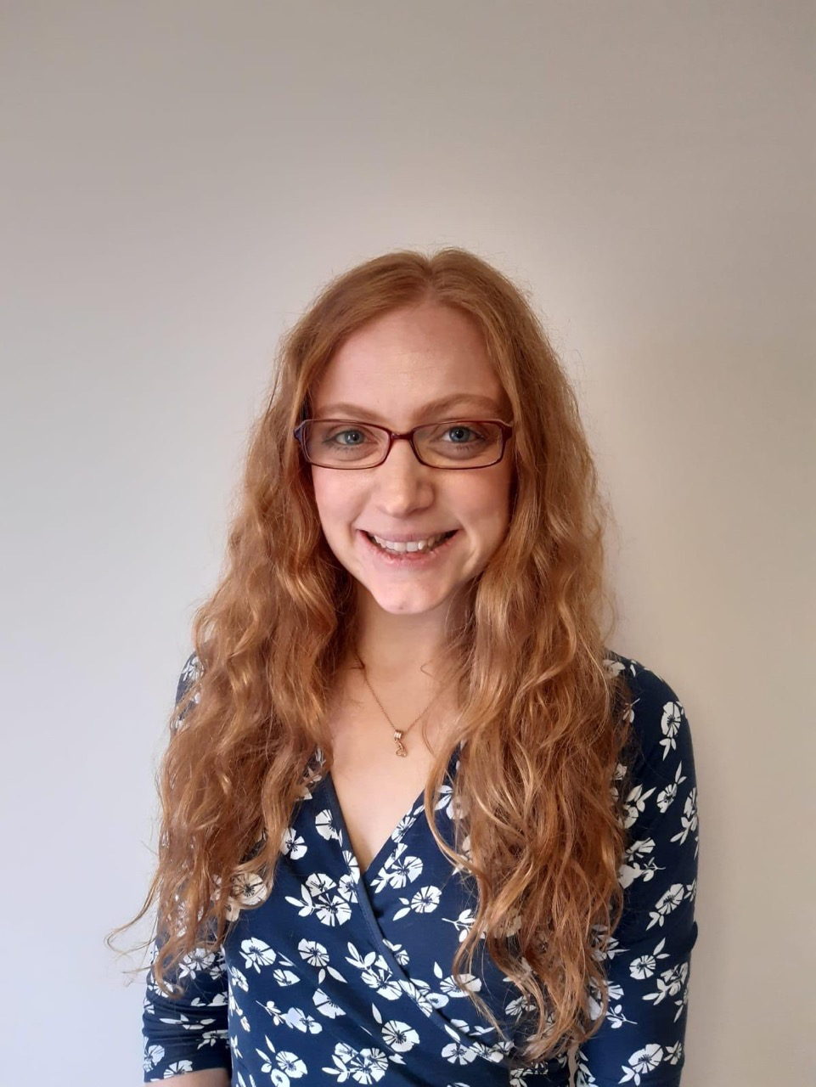
UK competitiveness
    The ambition
      Making the UK the best location to run and scale businesses and markets of the future in service of sustainable growth.
    Our pledges
          To unlock investment and productivity through planning reform and infrastructure delivery
          To make the UK M10 Mayoral group a more effective alliance for growth
          To drive the UK’s global connectedness across through trade and investment attraction.
    What we’ve done
          We’ve consulted members on the CBI’s regulation work in response to the DBT’s Call for Input. We also responded to the DBT’s Call for Input on the Turkey FTA
          We’ve established a new committee and working group structure for members to lead the debates on industrial strategy, trade & investment, geopolitical risk and infrastructure
          We’ve finished consultation across all UK regions on the role of industry and asks of local leaders ahead of the UK’s planned Mayoral elections.
    What we’ll do
          We’ll welcome political and policy figures to address CBI members including the National Infrastructure Commission, Chair of the Business & Trade Select Committee Liam Byrne and Shadow Trade Minister Gareth Thomas
          We’ll begin the post-election M12 Compact discussions with Mayors, aimed at making their collective markets an international calling card for investors
          We’ll launch a UK Regulation Taskforce.
        Find out more by contacting Mark Goldstone, Policy Manager, Will McGarrigle, Policy Manager, Helena Coe, Policy Manager, and Devon Geary, Project Manager

Slide 18


Financial services
    The ambition
      For the UK’s financial services sector to be world leading, enabling all sectors of the economy to innovate and grow in a sustainable way.
    Our pledges
          To promote financial services as an integral enabler to thriving economies
          To maintain the UK's competitiveness as a place to invest in financial services
          To be the business voice on financing the transition to net zero, championing sustainable finance.
    What we’ve done
          We’ve responded to the TSC’s SME lending inquiry highlighting the main issues for SMEs, and the DESNZ Scope 3 emissions call for evidence
          We’ve engaged with a variety of stakeholders, including HMT’s financial services representatives, the FRC, and the Green Finance Institute.
    What we’ll do
          We’ll respond to the Treasury’s consultation on UK Green Taxonomy, the Transition Plan Taskforce consultations on large corporate disclosures for DBT, and sector-specific guidance by the FCA
          We’ll run a roundtable with HMT on financial services VAT.
        Would you like to find out more about current and upcoming Financial Services opportunities, meetings or events? Contact Megan Bulford, Director, Financial Services.

Slide 19


Tax
    The ambition
      For the UK to have a business tax system which is world beating because it is simple, certain and the costs of administering it are proportionate to the revenue raised.
    Our pledges
          To digitalise the business tax system smartly
          To use tax to support other government aims on productivity, net zero and devolution
          To simplify the business tax system
          To ensure the UK tax system is truly internationally competitive.
    What we’ve done
          We persuaded the Chancellor to make full expensing – which allows companies to deduct 100% of qualifying plant and machinery costs from taxable profits – permanent.
          We contributed to Labour’s Business Tax Plan, which accepts many of the CBI’s recommendations to improve the UK’s tax system.
    What we’ll do
          We’ll continue to to build our case for business rates reform and for introducing a best-of-all-worlds R&D tax credit system
          We’ll continue to work with HMT and HMRC to simplify and digitise the UK tax system.
        Would you like to find out more about current and upcoming opportunities in Tax? Get in touch with Alice Jeffries, Tax Policy Manager.

Slide 20
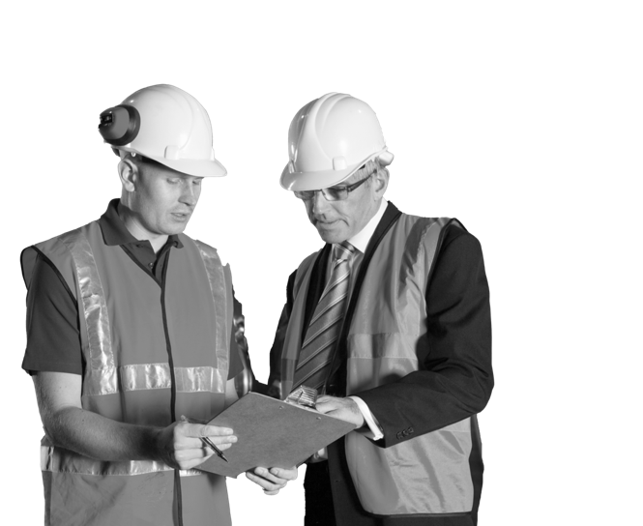

Economic intelligence and policy
    The ambition
      To help our members understand the economic environment they operate in so they can anticipate trends in demand, identify potential resourcing issues and understand the impact of policy changes, getting a head start in planning or troubleshooting.
    Our pledges
          To provide high-quality surveys and data
          To share valuable publications and insight
          To deliver economic briefings which meet the needs of our members
          To carry out rigorous economic policy analysis.
    What we’ve done
          We’ve published a wide range of economic intelligence including the UK Economic Forecast, the Economy in Brief, the Economic Deep Dive, and topical analysis on developments in the global economy, inflation, and more.
    What we’ll do
          We’ll continue to conduct our regular surveys examining conditions in key sectors. We’ll also produce regular analysis to keep members up-to-date with the latest economic data and trends, as well as regular engagements with members and stakeholders.
          See our latest economic intelligence
        To find out more about Economic Intelligence and Policy, including current and upcoming opportunities, please contact Louise Hellem, Chief Economist.

Slide 21

CBI Economics
    CBI Economics is the economic consultancy division of the CBI, offering products and services to empower businesses with the information they need to succeed and grow.
      We offer commissioned business surveys, bespoke economic analysis as well as bespoke products such as economic briefings. Our clients range from UK businesses, including universities and their commercial arms, to trade associations and government bodies.
      As a team, we have strong experience in modelling the economic impacts of company activity, their investments, or the contributions of sectors of the economy.
      However, our work goes beyond analysing economic data to provide insights that are informed by our deep understanding of policy and government. This allows us to produce research that not only has a real-world impact but is also highly accessible to both the media and key stakeholders in the public and private sector.
      "The team delivered a gold-standard piece of research which will inform policy making on air pollution for years to come. Their forensic economic analysis and world-class reputation is invaluable in providing policymakers with the evidence they need to deliver action for clean air.“ – Clean Air Fund
      Learn more about CBI Economics
      Note: These are additional paid-for services available to CBI members and non-members. CBI members receive a 10% discount on these services.

Slide 22
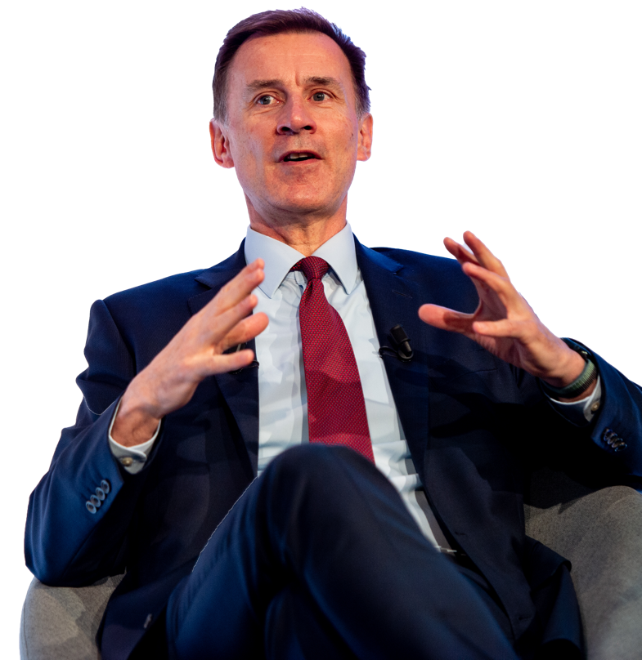
Political engagement
that delivers for business
    Some of our recent highlights:
        Our CEO Rain's recent engagements includes meetings with Chancellor Jeremy
        Hunt MP, Shadow Chancellor Rachel Reeves MP, the Government’s Head of
        Business Engagement, Rick Bowman, the Prime Minister’s Business and
        Investment Adviser, Franck Petitgas to name a few.
“I have really valued interactions with you (Rain Newton-Smith) and the CBI and others in this room, and I'm grateful for that.”
Rt Hon Jeremy Hunt MP, Chancellor of the Exchequer
Rain has re-joined the B5 and shadow B5 business groups
On Monday 20th November, we had both the Chancellor, Jeremy Hunt, and the Shadow Business Secretary Jonathan Reynolds speak at our General Election Countdown Conference.
In recent months, Sir John Armitt, Chair, National Infrastructure Commission; Lord Harrington – leading government's review into Foreign Direct Investment; Shadow Energy Secretary Ed Miliband MP and Gareth Davies, Permanent Secretary at the Department for Business and Trade have all addressed key CBI member forums.

Slide 23

How you can get involved
      The CBI’s extensive engagement with political stakeholders and officials is vital to shaping the policy and regulatory environment firms operate in. Over the coming weeks and months, there are many opportunities to have your business’ voice heard on the issues that matter most. Here are some key opportunities for member engagement.
      To get involved or to hear more about member opportunities, please contact your Account Manager, or visit the link below.
      Explore the latest member opportunities

Slide 24
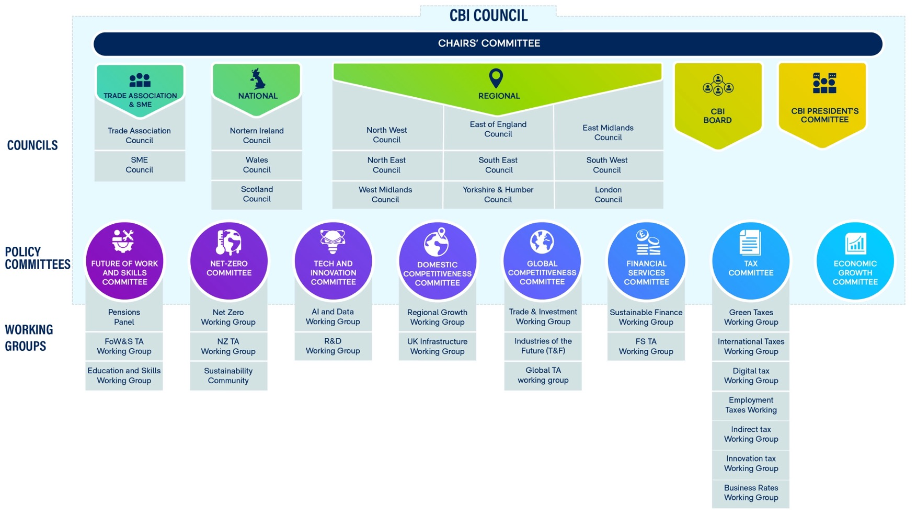
A full list of our Working Groups and Committees

Slide 25
Supercharge your membership
We hope this resource has helped you understand the many ways you can
make the most of your membership. There are so many unique experiences
and insights your business can benefit from, but these are our top three recommendations if you’re not sure where to start:
Register for one of our events to learn, connect and be inspired
Refer another member of your senior team through your account
manager
Read our latest economic analysis
If you’d prefer a conversation about the best ways to make the most of
your membership, get in touch with your Account Manager who will be
happy to help you.
Damian Waters
Director, North West
Damian.waters@cbi.org.uk

