Slide 1
Welcome to our GC Virtual Menopause Café
18 October 2023
Facilitator: Cheryl Madden (Organisational Development and Learning Consultant at GC) and guest speaker – Lisa Wright from Menopause the Wright Way.
Notes:
**We’re going to record the first part of this session for those who are unable to join today but we will stop recording before we open up to questions to ensure colleagues feel comfortable.
Welcome to our 3rd annual virtual menopause café session, I’m Cheryl Madden and I’m an Organisational Development and Learning Consultant at GC. I Chair the Health and Wellbeing EDI Network and Mental Health Champion group.
Working with the Women’s EDI Network we launched a Menopause Policy and Guidance earlier this year and thought World Menopause Day which is today would be a good opportunity to remind colleagues of the support available as well as continue to increase awareness and normalise the conversation on this important topic.
This session is open to anybody to attend, as it’s a topic which either affects people personally, or you might know a friend, partner or colleague going through this life transition – so it’s worthwhile understanding more about this and having the opportunity to ask questions and share recommendations.
The café is an open, respectful and confidential space where people can express their views safely.

Slide 2
What to expect in our virtual cafe
What is the menopause.
Some of the key symptoms.
Introduction to Lisa Wright from Menopause the Wright Way and this year’s theme cardiovascular disease.
Signposting to additional support.
Open discussion (**will stop recording):
Vicky McDonald - Director of HR and Organisational Development sharing her lived experience
We want to encourage other colleagues to share examples of what’s helped to manage symptoms
Q&A
As a reminder, the café is an open, respectful and confidential space where people can express their views safely.
Notes:
During the session we’ll talk about the menopause, as well as raising awareness of the support options available for improving health and wellbeing.
We will share some useful resources, as well as provide an update on steps GC are taking to offer more support in this area.
We want to introduce you to Lisa Wright from Menopause the Wright Way who is going to talk a little about the theme for World Menopause Day this year which is ‘cardiovascular disease’
Vicky McDonald is going to share some of her lived experience to start the discussion and we want to encourage you to share your experiences and examples of what may have helped you to reduce symptoms
We’ll have time to share recommendations and answer questions at the end of the session.

Slide 3
What is the menopause?
The menopause is a natural event in the life of many women, non-binary and trans people, during which they stop having periods and experience hormonal changes such as a decrease in oestrogen levels.
It usually occurs between the ages of 45 and 55 and typically lasts between four and eight years.
The experience of each person will differ, and menopausal symptoms can occasionally begin before the age of 40.
Perimenopause (or menopause transition), begins several years before the menopause.
You have reached the menopause when you haven’t had a period for a year.
Notes:
People are said to have reached the menopause when they haven’t had a period for a year.
The symptoms last on average for four years, but for some can last much longer.
Everyone’s journey through the menopause is unique to them.

Slide 4
Example symptoms
Psychological/emotional | Cognitive | Physical
Mood disturbances | Anxiety | Muscle and joint stiffness, aches and pains
Irregular periods and/or periods can become light or heavy | Headaches | Night sweats (hot flushes that happen during the night)
Fatigue | Memory loss or unable to recall words (also referred to as brain fog) | Hot flushes (brief and sudden surges of heat usually felt in the face, neck and chest)
Lack of sleep | Panic attacks | Recurrent urinary tract infections (UTIs) including cystitis
Irritability | Lack of focus | Weight gain and change to body shape
Higher levels of stress | Poor concentration | Skin changes (dryness, acne, general itchiness)
Lower morale | Depression | Palpitations (heartbeats that become more noticeable)
Lower confidence | Changes to mood and self-esteem including higher levels of irritability (impacting on relationships with others) | Changes in hair colour, texture and volume
Notes:
There are more than 34 menopause-related symptoms that can be categorised as physical, psychological/emotional and cognitive that can last for several years. Here are some of the key symptoms which may sound familiar.
Symptoms can affect a colleague’s comfort and performance at work.
*The most common 4 symptoms from those colleagues who completed the recent survey include:
Problems with memory or concentration (often referred to as brain fog)
Difficulties sleeping which may be as a result of night sweats
Changes in mood like low mood, anxiety or lower self-esteem
Hot flushes to face and neck which can make you feel dizzy
*Before we signpost to additional support and open it up to Q&A at the end we are going to introduce you to Lisa Wright from Menopause the Wright Way who is going to talk about the theme this year which is cardiovascular disease.
Therefore, the most troublesome symptoms tend to be mental rather than physical and, as a result, will not always be "visible".
Remember, everyone is different.
Symptoms can fluctuate and be felt to varying degrees The NHS website provides further information.

Slide 5
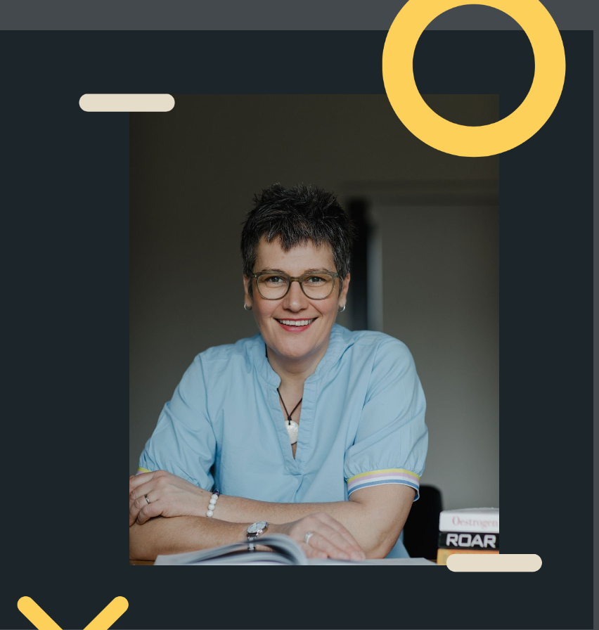
Introduction to Lisa Wright
Notes:
Lisa to introduce and provide an overview of their background.

Slide 6
Cardiovascular disease and the menopause
Key facts
Risk factors
Recommendations
Notes:
Lisa to run through each point and provide a link to further resources following the session.

Slide 7
Supporting colleagues
GC has committed to the Menopause Workplace Pledge (Women of Wellbeing) whereby we are:
Recognising that the menopause can be an issue in the workplace and women, non-binary and trans people need support.
Talking openly, positively and respectfully about the menopause.
Actively supporting and informing our colleagues affected by the menopause.
Notes:
As part of this commitment,
All managers should:
Have an open-door policy – if they suspect that a colleague is struggling due to menopause, ask how they are and be available to talk.
Know the support available.
Educate themselves – there are several resources available signposted in our policy and guidance
Colleagues should:
Seek help if needed – both internally and externally
Speak to others including their manager, colleagues and/or internal support group
Educate themselves on the symptoms and available support
The central human resources team will:
Provide support and training to colleagues and managers to increase awareness.

Slide 8
Support at GC
Employee Assistance Programme.
Health and Wellbeing EDI Network
Menopause Policy and guidance.
Menopause Support Group via Teams.
Menopause training via P.A.L (for managers and colleagues).
Mental Health and Wellbeing Policy.
Mental Health First Aiders.
Wellness Action Plan
Menopause Support and Guidance on Our Working Way
Notes:
We want all colleagues to feel comfortable seeking support while experiencing and managing menopause. Here’s a list of some of the additional support available to access at GC
The policies can be access on the Intranet (Group Policies) and a Menopause page on OWW
Training on PAL
We have uploaded a recording of our previous session which Lisa ran earlier this year via P.A.L
There are short online courses available on P.A.L which provide further guidance (there’s a 15 minute short video for colleagues and 45-minute module for managers as well as a recording of the session Lisa ran earlier this year)

Slide 9
Additional resources
Apps
Balance app which provides a library of medically approved content.
Calm (meditation and mindfulness).
Peppy digital health app | Menopause support and more | Peppy.
Books
Managing hot flushes and night sweats: a cognitive behavioural self- help guide to the menopause by Myra Hunter.
Menopause, The One Stop Guide by Kathy Abernethy.
Menopause: The Change for the Better' by Deborah Garlick.
Men... Let’s Talk Menopause' by Ruth Devlin.
Preparing for the Perimenopause and the Menopause by Dr. Louise Newson.
The Business of Menopause: A Guide for Working Women by Bev Thorogood.
Websites
Bupa Women’s Health Hub: Menopause support.
British Menopause Society.
Daisy Network Charity (support for premature menopause).
Menopause Café, which provides information about events where strangers gather to eat cake, drink tea and discuss the menopause.
Menopause Doctor - Balance website founded by Dr. Louise Newson and includes a library of resources).
Menopause matters, which provides information about the menopause, menopausal symptoms and treatment options.
Menopause Support.
NHS guidance on menopause.
Women’s Health Concern (the patient arm of the British Menopause Society).
Notes:
For those who are looking for further support, our menopause guidance refers to this selection of apps, books and websites in case of interest.

Slide 10
Let’s Talk Menopause
Notes:
**We’re going to stop recording now to encourage all attendees to feel safe and comfortable to ask questions and share experiences.
*Vicky McDonald –Director of HR and Organisational Development to share some of her lived experiences before we open the floor to ask attendees:
Any questions?
What has helped to manage symptoms?
Any key takeaways?

Slide 11
Thank you for joining
Any questions or recommendations to share?
Notes:
Thank you to our guest speaker Lisa Wright and Vicky for sharing their lived experience, we hope you found the session useful.
Just to mention, we have organised the following:
20 Oct - Wear it Pink Day this Friday (please see GC News for details of how to make a donation to the Breast Cancer Charity)
15 Nov (1-2 pm) Andy’s Man Club virtual session with a representative from Andy’s Man Club

