Slide 1
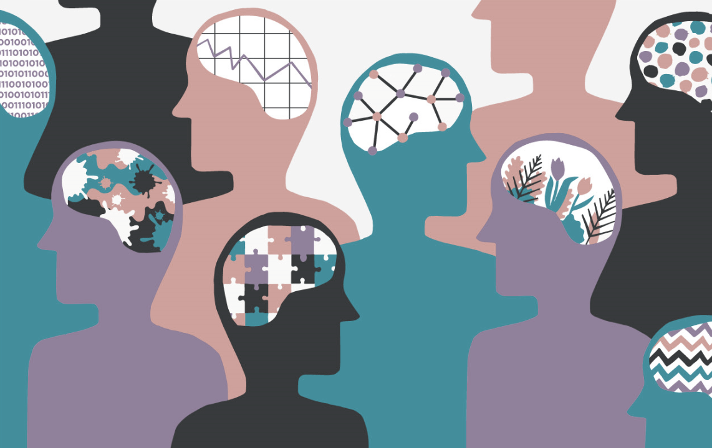
Neurodiversity Awareness Lunch & Learn 2 Getting the Communication Right
Health & Wellbeing EDI Network, The Growth Company December 2nd, 2021 – Julie Casanova

Slide 2
Session Outline
Short Presentation (recorded)
Principles of neuro-inclusive communication
Julie Casanova, Safeguarding Lead & EDI Member
Guest speakers (recorded)
(1) Working with neurodiverse people in aspirational contexts
Emma Bennett, Employment Coach and DSO
(2) Creative communications, neurodiversity and the arts
Emma Loughran, schoolteacher
Q&A (not recorded)

Slide 3
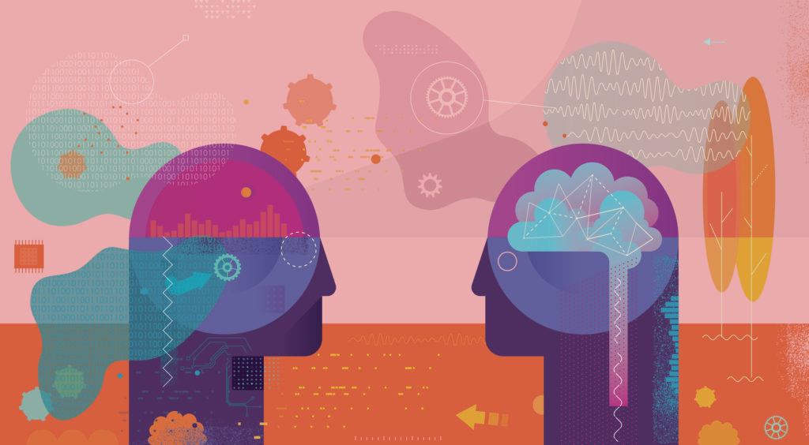
Programme of Events
This week
Sharing of resources, anonymous testimonies, neurodiverse celebrity role models on our GC landing page.
Send your contributions to julie.casanova@growthco.uk or healthandwellbeing@thegrowthco.uk.
Next month
Lunch & Learn 3: Neurodiversity in the Workplace (January 13th, 1pm)

Slide 4
Reminder: What is Neurodiversity?
Neurodiversity encompasses a wide range of conditions. Examples include:
Dyslexia
Autism
(ASD)
AUTISM
ADHD
Anxiety
Depression
OCD
Dyspraxia
Bipolar
Disorder
Tourette
Syndrome
Down Syndrome
Dyscalculia

Slide 5
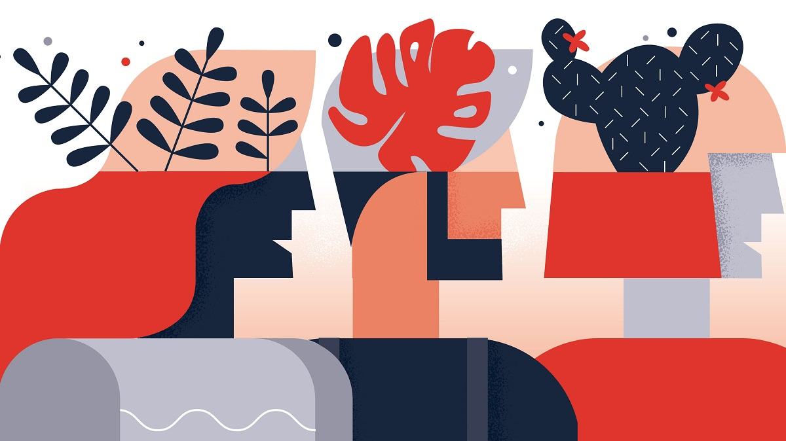
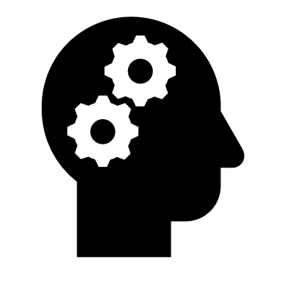
Reminder: What is Neurodiversity?
Neurodiversity (aka “neurodivergence”) is a positive term coined in the late 1990s to celebrate the diversity inherent in human brains.
It refers to natural variations and differences in the human genome that affect how people…
COMMUNICATION
THINK
PROCESS
LEARN
BEHAVE

Slide 6
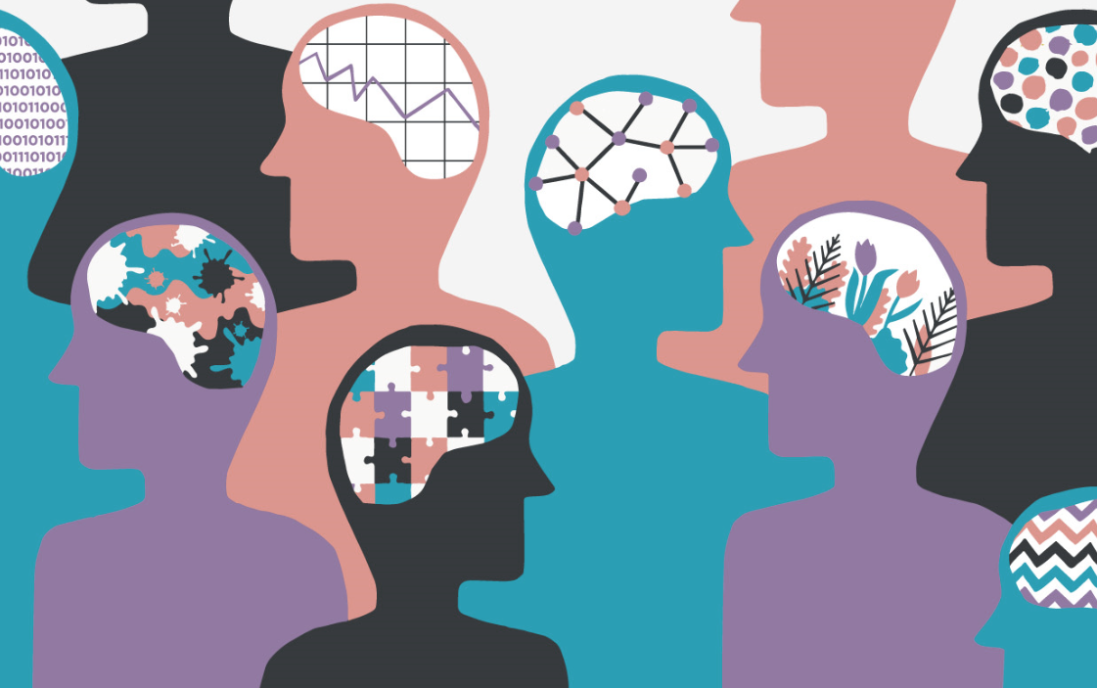
Neurodiversity & Communication
While viewing the world differently can be an asset, it can also be a challenge when it comes with interacting with others. Neurotypical standards make it particularly difficult for neurodiverse people to communicate.
Barriers to day-to-day communication can be linked to:
Communication Issues
Interaction/Social Issues
Emotional Challenges

Slide 7
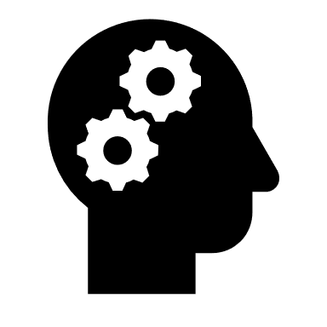
Neurodiversity & Communication
Brainstorming
Communication
Issues
Interaction/
Social Issues
Emotional
Challenges
Speech impairment (e.g. stammering)
Low literacy, problems with reading
Difficulties with using or understanding spoken language (e.g. non-verbal)
Repetition of words (echolalia)
Slurred speech or intelligible sounds
Forgetting words
Social anxiety
Difficulties with reading social cues
Low regulation of attention and focus
Memory issues
Uncommon focused interests
Different perspectives on reality
Rejection sensitive dysphoria
Low sensory threshold
High levels of frustration
Pessimism
Anxiety and panic attacks
Low self-esteem

Slide 8
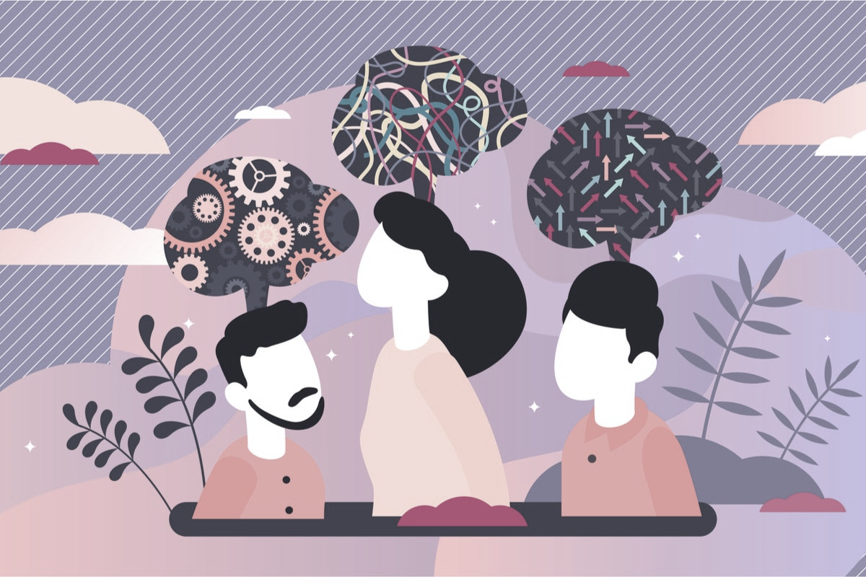
Neuro-inclusive communication:
Key Principles
Remember that communication is a two-way street (“double empathy problem”);
Be as flexible, patient and understanding as possible;
Be clear and direct, avoiding ambiguous statements;
Adapt communication styles to each individual’s needs and ask them what works for them (person-centred approach);
Increase your knowledge of alternative communication styles and explore non-verbal or creative communication options;
Do not humiliate people for approaching reality differently; do encourage them to share their perspectives with you.

Slide 9
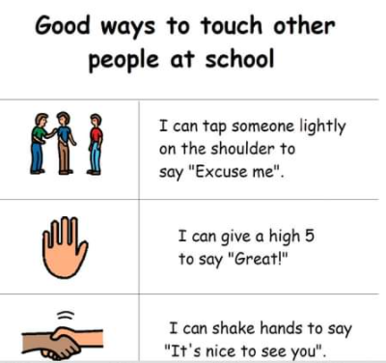
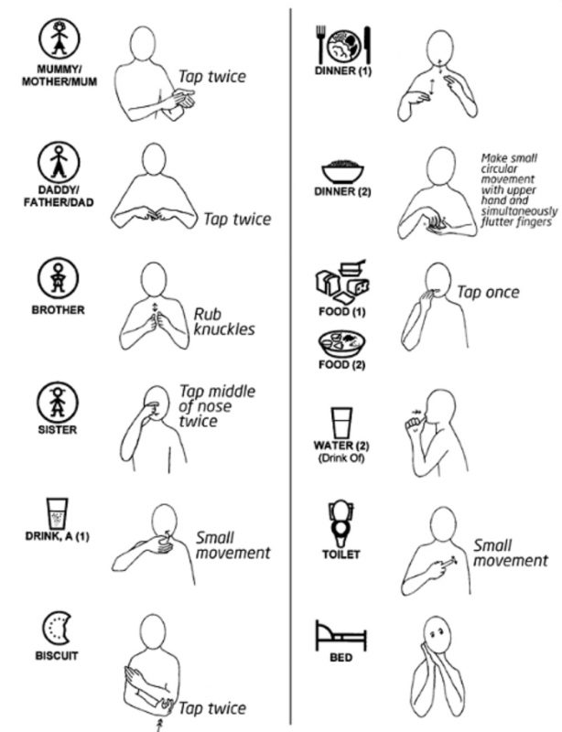
Alternative Communication Techniques
Remember that communication is not only verbal and that people may find alternative communication forms easier:
BSL: British Sign Language
Mackaton: combination of symbols and signs
PECS: Picture Exchange Communication System
Social Stories: combination of text and images
Many neurodiverse people have found solace and freedom in artistic forms of expression, such as music, painting, dancing, singing and theatre.
Exploring creative communication forms fosters inclusion.

Slide 10
Adapting Communication
Case Study 1
Your colleague Kasia is autistic.
She is easily distracted by noises and can feel very anxious in loud environments.
She does not make eye contact as she is highly attuned to sensory details and looking into a person’s eyes causes an overload of information.
She feels isolated at work but finds interaction with people very difficult.
She is passionate about science fiction movies.
How would you make interactions and communication easier for Kasia to feel included?

Slide 11
Adapting Communication
Case Study 2
Your colleague Tom has ADHD and Tourette.
He struggles to focus during conversations when he is anxious or distracted, and often forgets information such as people’s names.
He has a very ebullient personality, and is cheerful most of the time. When he is really excited, he tends to shout or repeat sounds.
When meeting new people, he can be very quiet. He fidgets a lot, stammers, and clears his throat repeatedly.
Despite being rather confident, Tom easily feels rejected and fears criticism.
How would you make interactions and communication easier for Tom to feel included?

Slide 12
NEURODIVERSITY
QUIZ
Terminology

Slide 13
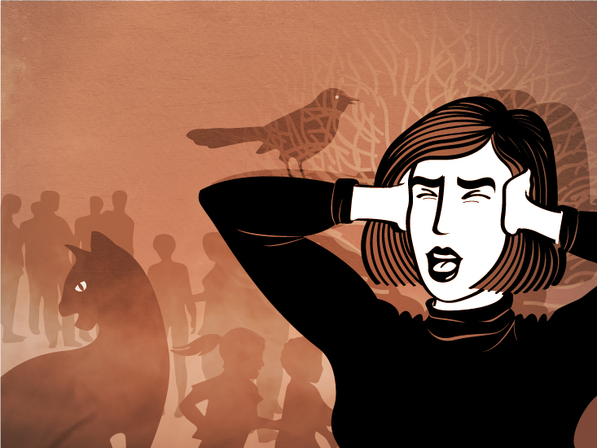
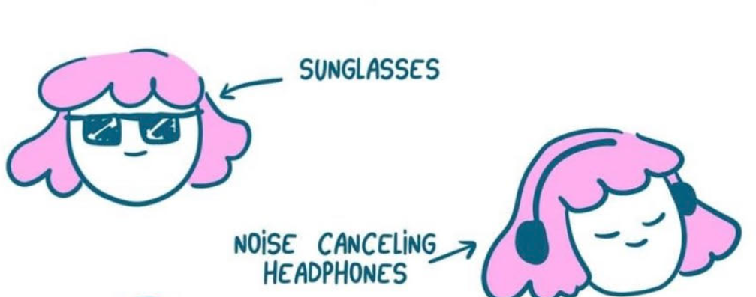
WHAT IS “SENSORY OVERLOAD”?
Sensory overload is when your five senses take in more information than your brain can process.
As a response, your brain may enter fight, flight or freeze mode to cope with this crisis.
Many neurodiverse people have SPD: Sensory Processing Disorder. They display higher levels of physical sensitivities and emotional reactivity.
Something too loud, too bright, too sticky, too boring, too stressful may be highly distressing for someone with autism or ADHD. It might trigger panic attacks and emotional meltdowns.
Try to be open-minded when it comes to Reasonable Adjustments for people experiencing SPD:

Slide 14
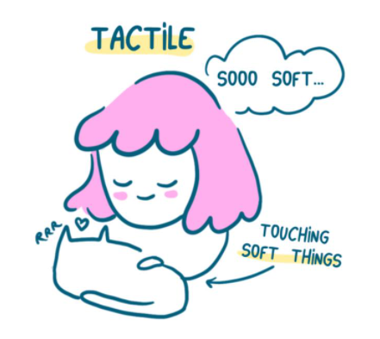
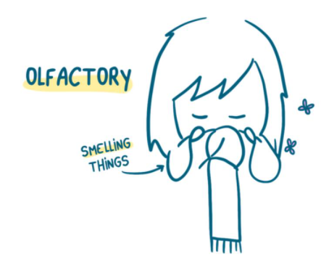
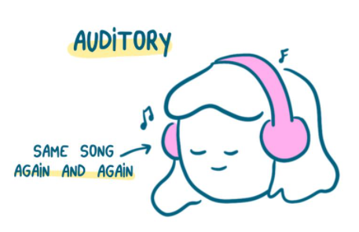
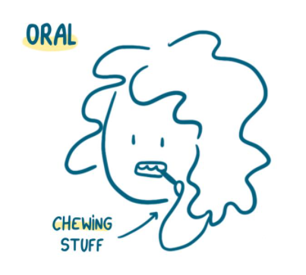
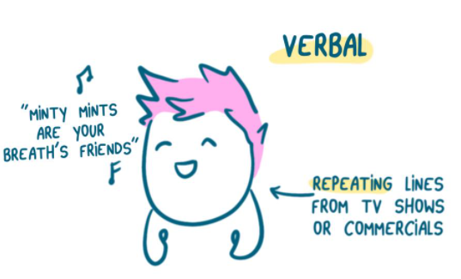
WHAT IS “STIMMING”?
Stimming is a word used to refer to self-stimulating behaviours. While this behaviour is generally associated with autism, many neurodiverse people display stimming behaviour (e.g. ADHD). There are many types of stimming:
Biting your nails, twirling your hair, drumming your fingers, cracking your knuckles, tapping your pencil are instances of stimming. Everyone engages in self-stimulating behaviours.
Neurodiverse people might display uncommon forms of stimming. It might be more obvious and go on for long periods. It might be perceived as more disruptive to others. Examples:
Flapping of hands
Rocking back and forth
Bouncing or jumping
Repeating words or phrases
Picking scabs
Pacing or walking on tiptoes

Slide 15
WHAT IS “STIMMING”?
Reasons for stimming differ. Neurodiverse people may stim to:
For many, stimming is a way of counteracting an overwhelming sensory environment and alleviating high levels of internal anxiety.
In other words, this type of behaviour may be self-soothing.
Avoid interfering with stimming behaviour unless it is harmful for the individual (e.g. head banging).
Better focus
Feel less bored
Release energy
Cope with emotions

Slide 16
WHAT IS “MASKING”?
For many neurodivergent people, masking is a survival tool for engaging in neurotypical societies and organizations.
Masking is the artificial performance of social behaviours deemed more “socially acceptable”. The need for masking is symptomatic of a society that is not inclusive of differences.
Concretely, masking means people make extra efforts to compensate and adapt.
Examples of masking to adapt include:
Copying a person’s body language or forcing eye contact to hide social difficulties
Hiding or talking less about your special interests that could be perceived negatively
Forcing yourself through uncomfortable sensory discomfort to hide sensitivity
Setting a lot of reminders to hide forgetfulness and attention issues
Masking and compensating can be exhausting. Some people are never diagnosed because they hide their struggle so well.
It may lead to depression and a sense of identity loss.

