Slide 1
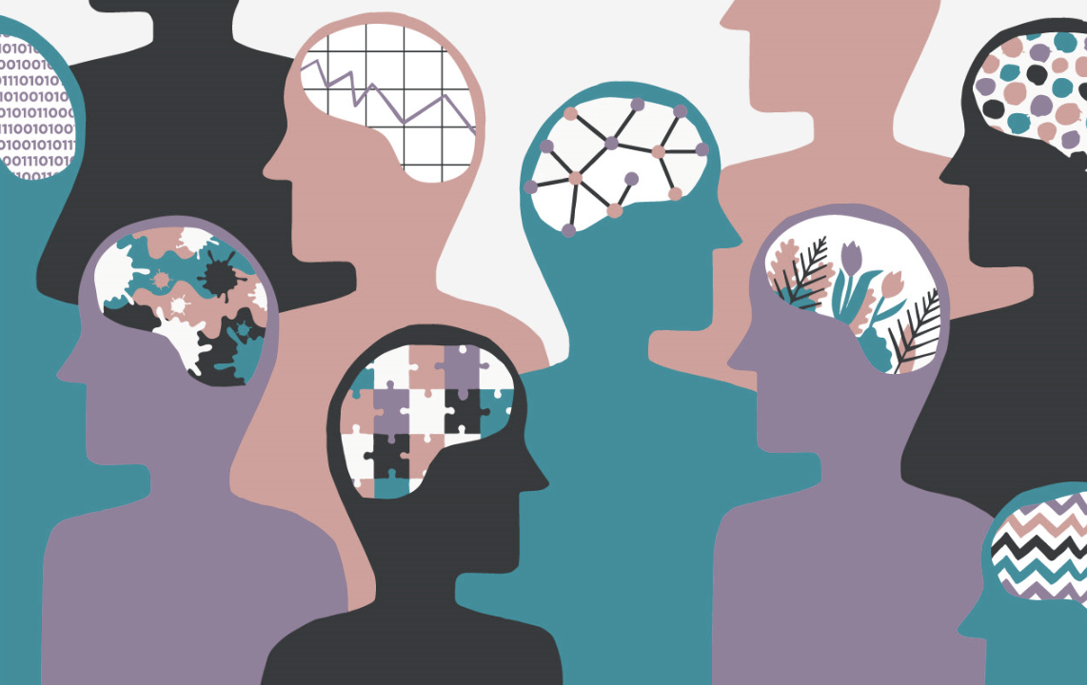

Neurodiversity Awareness
Lunch & Learn
Session 3
Neurodiversity in the Workplace
Health & Wellbeing EDI Network, The Growth Company
January 13th, 2022 – Julie Casanova

Slide 2
Session Outline
Presentation, activities & testimonials
Julie Casanova, Safeguarding Lead & EDI Member
Suggestion Box
Discussion: Driving Best Practice at GC
Future projects and activities
Please note that this session will be recorded.

Slide 3
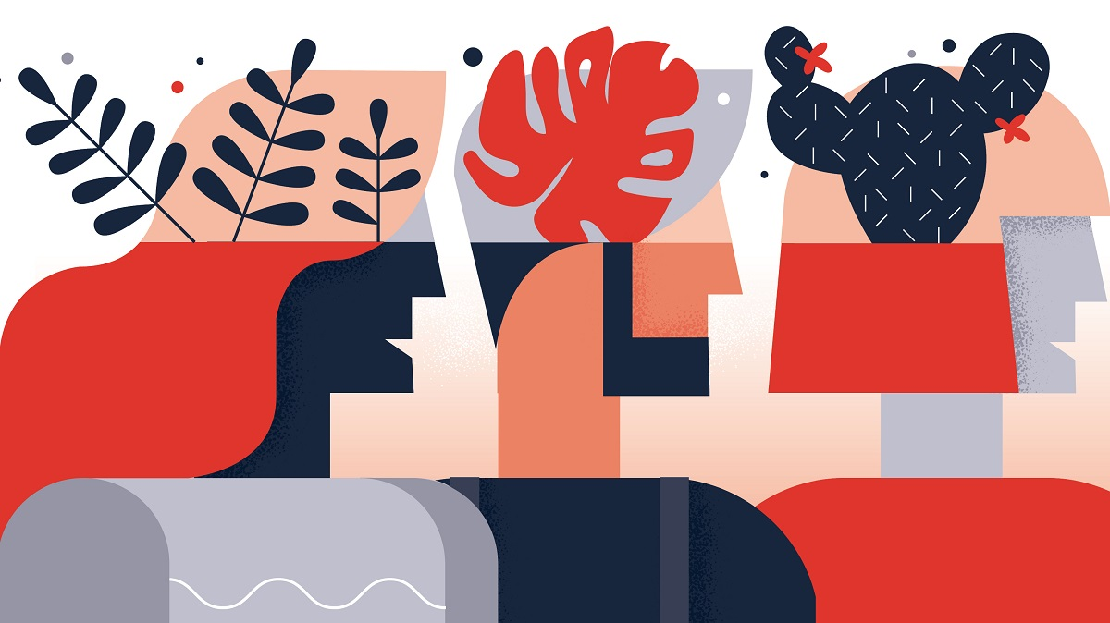

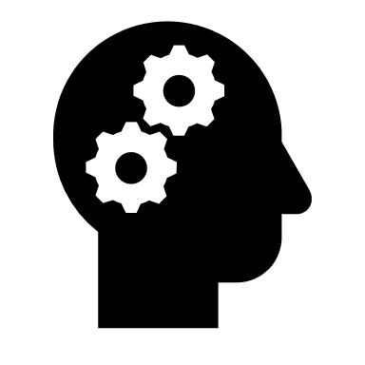


What is Neurodiversity?
Neurodiversity (aka “neurodivergence”) is a positive term coined in the late 1990s to celebrate the diversity inherent in human brains.
It refers to natural variations and differences in the human genome that affect how people…
THINK
PROCESS
LEARN
BEHAVE

Slide 4
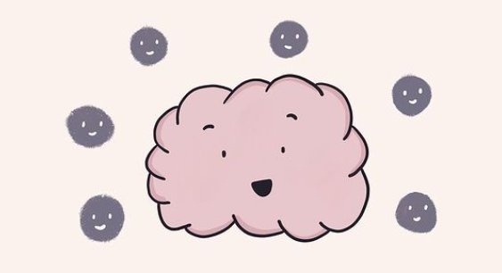
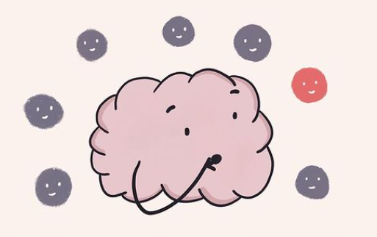
What is Neurodiversity?
Most people are neurotypical, meaning that their brain functions in the way that society expects.
Yet it is estimated that at least 1 in 5 people are neurodiverse and have unique traits, talents and challenges.

Slide 5
What is Neurodiversity?
Neurodiversity encompasses a wide range of conditions.
Examples include:
Dyslexia
Autism
(ASD)
AUTISM
ADHD
Anxiety
Depression
OCD
Dyspraxia
Bipolar
Disorder
Tourette
Syndrome
Down Syndrome
Dyscalculia

Slide 6

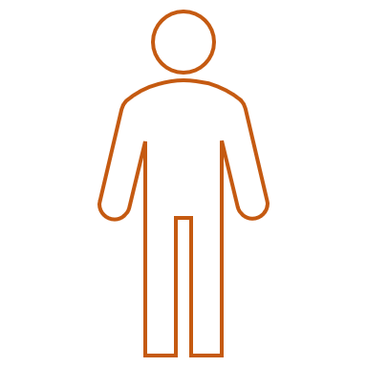

Neurodiversity in the Workplace
Despite growing awareness of neurodiversity and targeted recruiting methods:
6 millions of neurodiverse adults in the UK
1 million of them are unemployed or significantly under-employed
50%
Among this million: 500,000 autistic adults are not in work
£170 billion cost to the economy
*The Untapped Talent Pool*

Slide 7
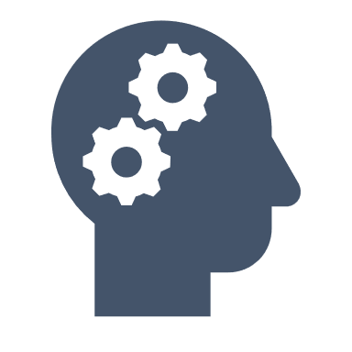
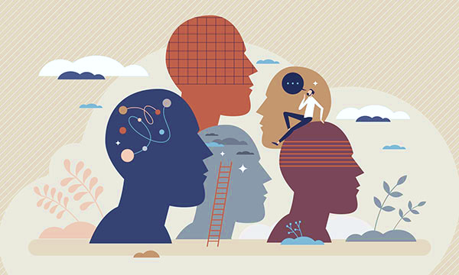
Untapped Talents
What talents do neurodiverse employees bring?
Neurodiverse strengths + diversity of neurotypes in organisation = competitive advantage
Creativity, innovation, lateral thinking
Highly specialised skills, strict consistency
Process improvement, problem-solving
Strategic analysis
Reliability, dedication
Loyal employees, staff retention
Heightened attention to details
Better understanding of customer needs

Slide 8




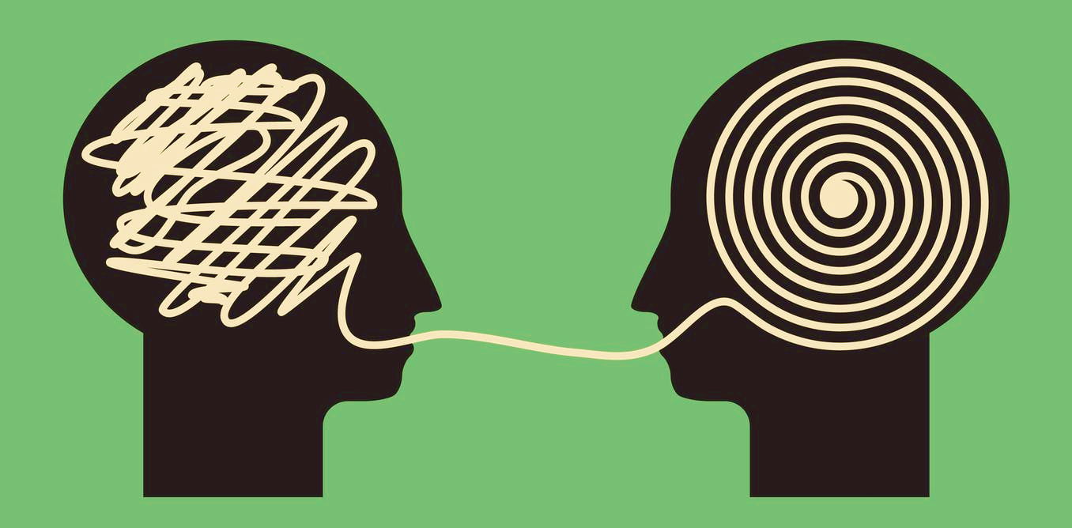


Neurotypical Workplaces
No strategy
No leadership
Insufficient money and resources invested
Discriminatory interview practices (focus on interpersonal attributes)
Lack of knowledge
Lack of awareness
Ill-adapted language and communications
Disclosures not encouraged
Ill-adapted work space
Inflexible timetables
No inclusion policy
Report by the Institute of Leadership & Management (2020) shows that:
  Half of managers admitted they would be uncomfortable hiring a neurodivergent individual;
  19% were confident neurodiversity was explicitly covered in policies and procedures;
  Highest level of bias exists towards Tourette Syndrome and ADHD/ADD.

Slide 9
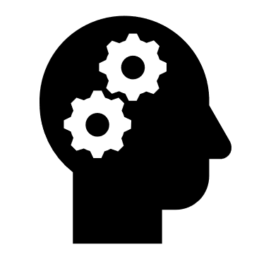















Exclusive Practices
Job Interviews - Case Study
What inclusive measures can we put in place?
Testimonial from a GC Employee Autism • Late diagnosis
Non-customer facing role
Interview Setup
Struggled to cope with anxiety when interviewed by 5 people
Found digital settings reassuring
Environment
Eye Contact
Did not dare to ask for Reasonable Adjustments to be in a sensory-friendly environment (quiet, no harsh lights)
Received job rejection feedback about missing eye contact prior to autism diagnosis
Competences
Social Interaction
Shortlisting
Lack of self-confidence during interviews due to anxiety was in the way of getting a job
Found assigned group tasks isolating and difficult, despite the help of support worker
Not shortlisted for jobs that met all skills and qualifications

Slide 10



Inclusive Employment Cycle
Any thoughts?
Recruitment
Onboarding
Development
Retention
Questions in advance
Interview > work trial
Adjust expectations
(eye contact)
Encourage disclosures
Reasonable adjustments
Encourage disclosures
Mentorship
Trained colleagues
Induction formats
More regular 1:1
Trained managers
Professional coaching
Additional training
Inclusive social events
Consultation for change
Adapted environment
Balance flexibility/structure
Equipment and resources (mind-mapping software, noise-cancelling headphone)

Slide 11
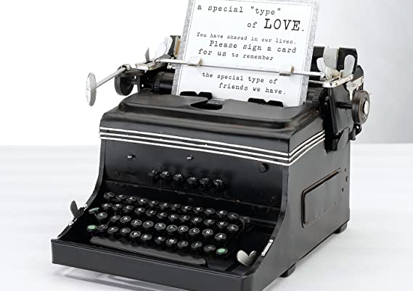


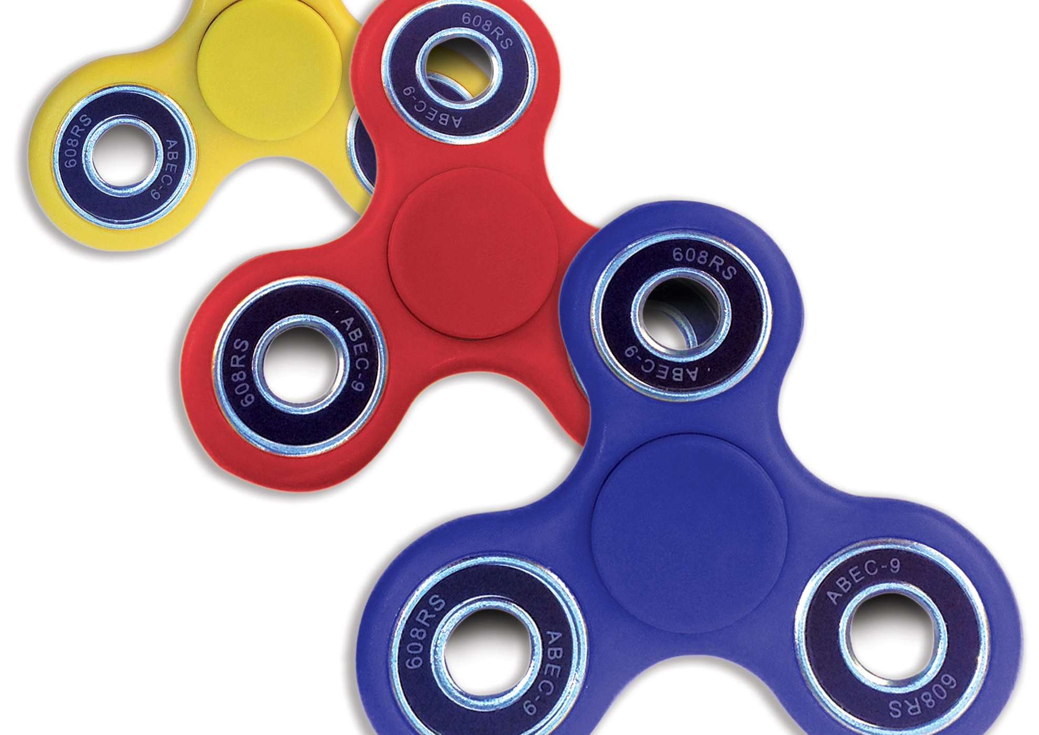
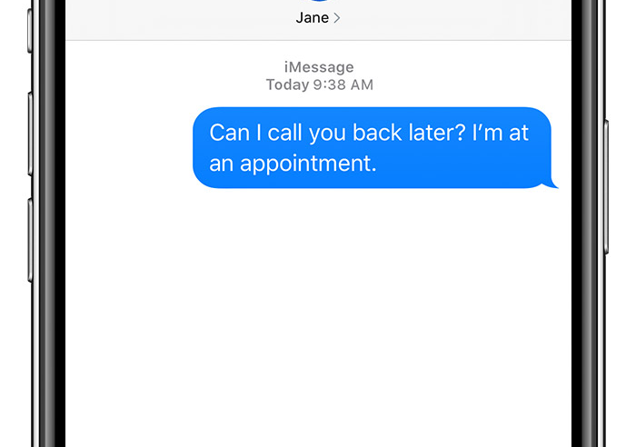
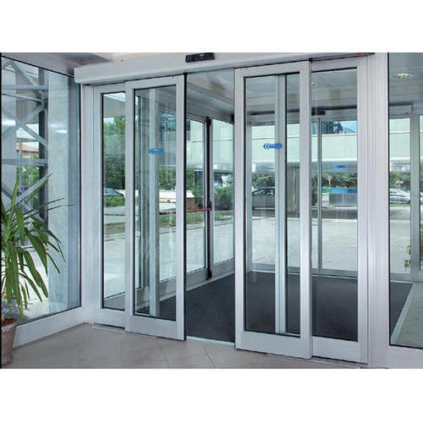
Guessing Game
What do these objects have in common?

Slide 12


Solution
First designed for disabled people but have now grown to become day-to-day objects used by everyone:
Typing machine: first produced by an Italian inventor for his blind friend, so that she may write letters;
SMS texting: idea of a Finnish inventor who wanted to support deaf people to communicate;
Automatic doors: invented by Americans engineers who saw people’s difficulties in opening swing doors;
Bendable straw: was invented by an American father whose daughter could not drink out of a straight straw;
Electric toothbrushes: created for patients with limited motor skills and orthodontic patients wearing braces;
Fidget spinners: first invented by an American woman to help children with ADHD and autism.
Universal Design benefits everyone.

Slide 13
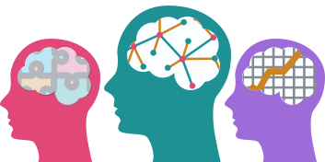
Key Principles of Inclusivity
Flexible work rhythms
Variety in comms styles
Assistive Technology
Easy to navigate environment
Structure incl. reminders
Strategy
Coaching
Equipment
Breaking down; bullet points
Sensory workspaces
Enforce a fit by aiming to change the individual
Rethink the environment instead of changing people

Slide 14
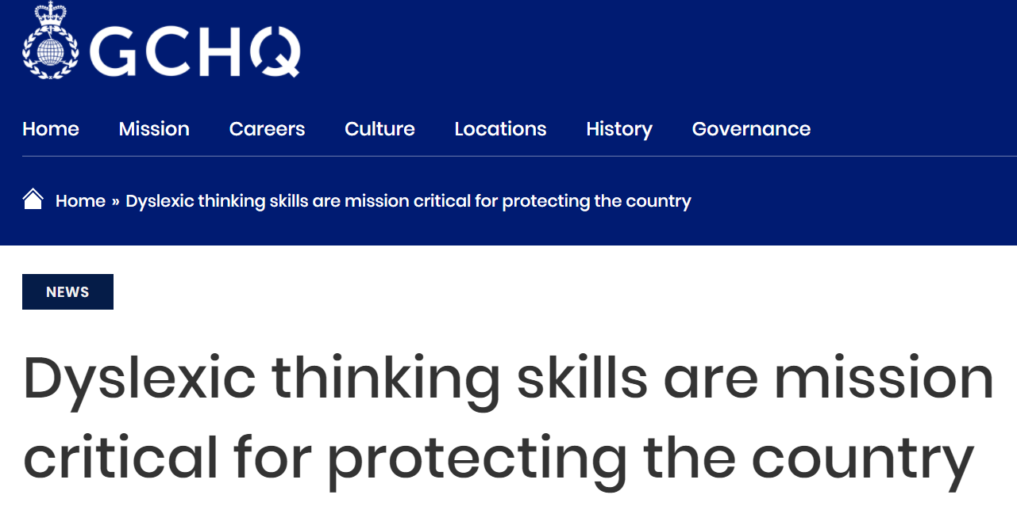


Tales of Inclusion - Case Study 1
Neurodiversity at GCHQ
HIRING
Proactively looking for people who can spot patterns that others miss.
Encourage applications from dyslexic people for this reason.
RETENTION
Some of our most talented and creative people have a neurodiverse profile – from people with autism spectrum conditions to dyslexia, and from dyscalculia and dyspraxia. For the last 20 years we have had a specialised neurodiversity support service, with specialist neurodiversity advisers, who offer awareness sessions for managers, as well as training so that managers can help staff with any adjustments they need to reach their full potential.
At interview stage:
Using a whiteboard or flipchart to ‘car park’ questions to return to later
In the workplace:
Mind-mapping software
Noise-cancelling headphones
Onscreen reading rulers

Slide 15

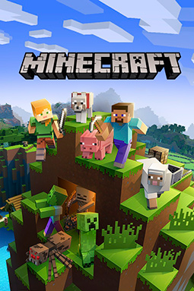
Case Study 2
Microsoft Neurodiversity Hiring Program
Multi-day hiring event to showcase skills in supportive and inclusive manner. On campus or virtual.
Monday
Meeting with managers of each hiring team
Tasks using Minecraft to foster collaborative problem solving
Tuesday
Practice interviews with real time feedback
Opportunity to learn more about Microsoft’s culture
Wednesday
Further Minecraft activities allowing candidates to showcase their skills, in line with Microsoft’s core competencies
Thursday
Final round interviews with each hiring team. All interviewers have received ND training. Job coaches on site. Long breaks.
80% success rate. Unsuccessful candidates are given feedback for future candidacy. Successful candidates receive coaching support for a year and a community mentor. Their team members are trained to understand ND.

Slide 16





Best Practice at GC
Mention of Reasonable Adjustments in all adverts
Guaranteed interview for applicants who meet the minimum requirements and are also disabled
Champion best practice and encourage businesses to become Disability Confident
July 2020: 9.7% of employees with a disability
July 2021: 10.2%
Objective to attract and retain a diverse workforce
Advertise job roles at Salford Disability Forum, GM Coalition of Disabled People, Breakthrough UK, Manchester Deaf Centre and other local organisations to reach a range of applicants

Slide 17


Best Practice at GC: Case Study
Weekly KITs to discuss workload, identify 3-5 focuses for the week, update on wider projects to avoid missed out information in emails & feeling of rejection
Deadlines against work that doesn’t have any
Deadlines against chunks of projects
Ben Ward – Business Development Executive, MIDAS
Diagnosed with ADHD aged 29 in 2020 during the pandemic
Diagnosed with Dyslexia aged 21
Project Management Support
Strengths-based Approach
Involvement in any public speaking opportunity and in front of audiences of executive level managers
Freedom to come up with new working processes and ways to do things in a way that keeps Ben engaged
Line Manager: Hannah Tracey – Head of CDT Sector Team, MIDAS
Challenges: Prioritisation • Breaking Down of Tasks • Anxiety • Imposter syndrome
Strengths: Creativity • Innovation • Public Speaking • Sociability
Allowed protected time for discussion with ADHD coach
Pastoral support and regular check-ins
Encouragements to counteract anxiety
Tailored Communication

Slide 18

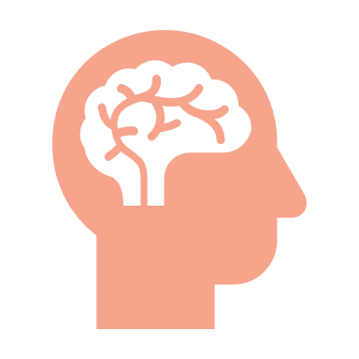
Suggestion Box
Driving best practice at GC…
…to better include neurodiverse people.

Slide 19



Resources and Future Events
Landing page for resources (testimonials, videos, tools…)
Future project ideas include:
    Collaboration with EDI Age Network and EDI LGBTQ+ Network (Autistic Pride Day, June 18th)
    Discussion cafes around Neurodiversity themes

