Slide 1

Wellness Action Plan Guidance for Colleagues
October 2023 (version 3)

Slide 2
Contents
What is mental health & wellbeing?
What is a Wellness Action Plan (WAP)?
Why did the GC commit to Mental Health at Work Standard?
Who is the guide for?
Key benefits of the WAP tool
Supporting your team members to develop a WAP
Reasonable adjustments
Top 10 evidence-based tips for promoting good mental health at work

Slide 3

What is mental health and wellbeing?
Mental health
‘Some people call mental health ‘emotional health’ or ‘well-being’ and it’s just as important as good physical health. We all have times when we feel down or stressed or frightened. Most of the time those feelings pass. But sometimes they develop into a more serious problem and that could happen to any one of us’ (Mental Health Foundation).
1 in 4 people will experience a mental health condition, which means someone you know may be struggling and need further support.
Mental wellbeing
‘Mental wellbeing describes your mental state; how you are feeling and how well you can cope with day-to-day life. Our mental wellbeing can change, from day to day, month to month or year to year’ (Mind).

Slide 4
Mental health in the workplace
How does poor mental health affect people at work?
Workplace Wellbeing Index 2020/21. Based on 28,830 total responses

Slide 5
What is a Wellness Action Plan?
The Wellness Action Plan (WAP) has been developed as a preventative tool to help promote good mental health and wellbeing.
We are trying to shift towards a more proactive and positive approach to wellbeing and believe that this tool can help support our people to promote good mental health.
The WAP is not legally binding but is intended as an agreement between a manager and a colleague to promote wellbeing or address any existing mental health needs, including any adjustments they may wish to discuss.
This tool as part of our ongoing commitment to the Mental Health at Work Standard (see next slide).
Notes:
The WAP is inspired by Mary Ellen Copeland’s Wellness Recovery Action Plan® (WRAP®): an evidence-based system used worldwide by people to manage their mental health and we adopted the Mind template.

Slide 6
What is the Mental Health at Work Standard?
The Mental Health at Work Commitment provides a simple framework for employers who recognise the importance of promoting colleague wellbeing
It sets out six clear standards based on what best practice has shown is needed to make a difference and better equip employers to create an environment where colleagues can thrive
These standards build on those set out in the independent Government-commissioned Thriving at Work review in 2017 and Time to Change Employer Pledge.

Slide 7
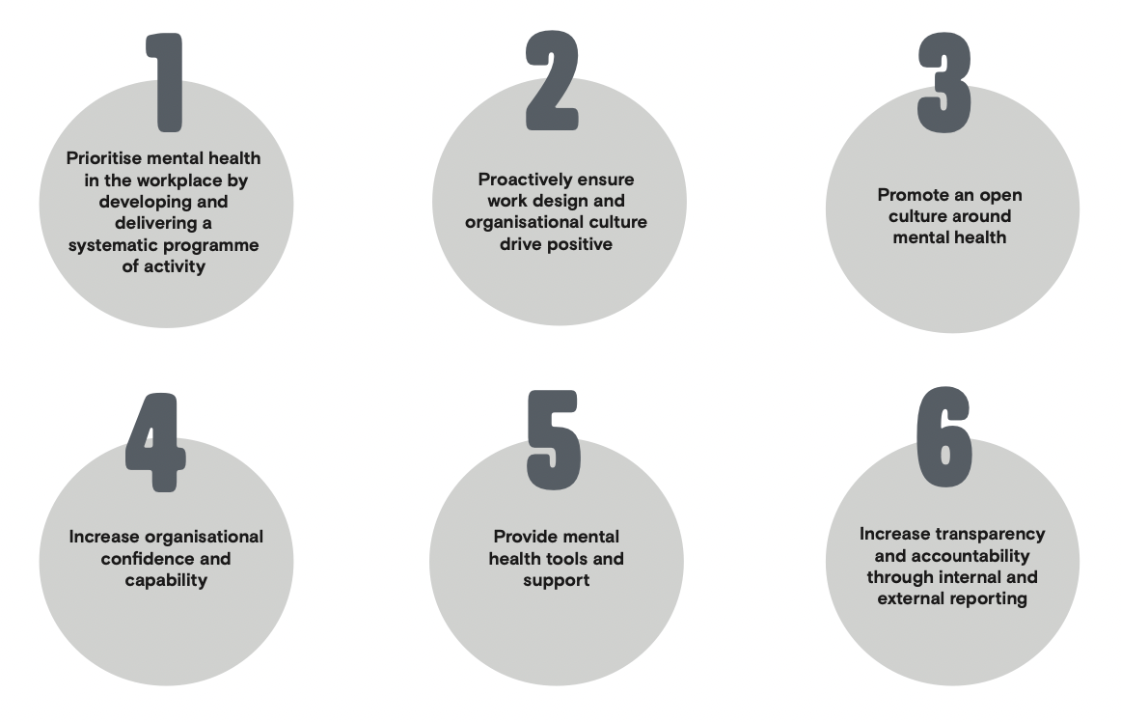
The Six Standards

Slide 8
Why we committed to the Mental Health at Work Standard
We’re committed to not only supporting health and wellbeing of our people, but also in creating an environment which encourages open conversation about mental health.
We want to raise more awareness that every individual is likely to move between periods of good and poor mental health throughout their lives, and this is completely normal.
We value the support of our Champions in playing a leading role in ending stigma around mental health and normalising the conversation in our everyday lives. If you are interested in becoming a Mental Health Champion, then please get in touch.

Slide 9
Who is the guide for?
This guide is designed for everyone in employment or a voluntary role who would like to learn more about how to use Wellness Action Plans (WAPs) to support and promote their mental health and wellbeing at work. You could be:
Currently well and interested in using the WAP as a proactive tool to map out what needs to be in place for you to be mentally well at work.
Currently experiencing a mental or physical health condition and want to find out how a WAP can help you.

Slide 10

Key benefits of using the WAP tool
Personalised, practical tool we can all use (whether we have a mental health condition or not) to help us identify what keeps us well at work, what causes us to become unwell, and how to address a mental or physical health condition at work should you be experiencing one.
Opens a dialogue with your manager, for them to better understand your needs and experiences and ultimately better support your mental health and wellbeing.
If you work remotely, a WAP can help you identify how best your manager can support you and overcome the barriers which this style of working can present.
WAPs are also particularly helpful during the return-to-work process if you have been off work due to a mental or physical health condition, as they provide a structure for conversations around what support will help you and what reasonable adjustments might be useful to discuss and consider with your manager.

Slide 11
How to get started…

Slide 12
How to get started in 3 easy steps
Plan some time on your own to fill in your WAP.
Schedule some confidential time with your manager to discuss it.
Consider what it would be helpful for your manager to know before the meeting.
Key points:
The WAP should be written and owned by you, expressing your personal experience and your needs.
Your manager’s role is to discuss the plan with you and provide support, including guidance on what is possible for any reasonable adjustments. It should be a collaborative process but led by you.
If your manager has not used a WAP before, then please refer them to the Wellness Action Plan Manager Guidance.

Slide 13

Remember…
The WAP needs to include all the things that are important to your mental wellbeing, from your triggers and signs of poor mental health, to what action to take and what support you may need when or if you become unwell.
Once the WAP has been drawn up, factor in sometime during your KITs to review the WAP and make any necessary changes.
The WAP is most effective when treated as a live, flexible document, so a regular ‘feedback loop’ with your manager to assess what is and isn’t working is an important part of the process.

Slide 14
Confidentiality
The WAP should be held confidentially by you and your manager. Make sure you are fully aware of how the information will be used, and only provide information that you are happy to share.
If you are filling out a WAP because of being unwell, your manager may ask whether you consent for a copy of it to be held with HR, along with any other information about your wellbeing, such as an Occupational Health report or a Return-to-Work plan (please refer to the Mental Health and Wellbeing Policy or HR Service Desk for further details).
For GC to fulfil its duty of care to keep colleagues safe at work, your manager will be obliged to break confidentiality if they believe you are experiencing a crisis. If they become aware that you or someone else is at serious risk of harm, they may decide to call the emergency services.
You and your manager should ensure that the personal data, including data relating to health, is handled in accordance with our data protection policy. Any breach of confidentiality will be treated very seriously and dealt with under our disciplinary procedure.

Slide 15
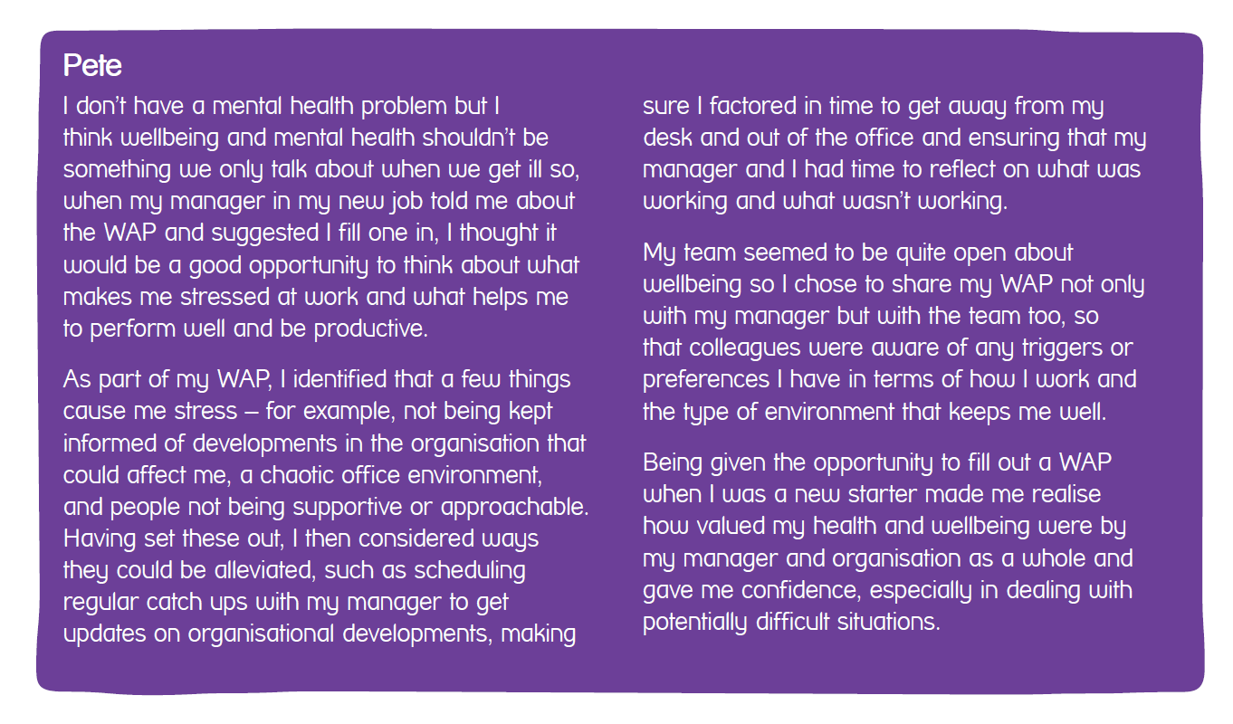
Example case study
Notes:
Often the necessary change is one of attitude, expectations or communication rather than a major or costly change.
The agreed steps in this example case study were effective because they explored individual needs and put in place practical, easy to implement approaches or adjustments based on these needs.

Slide 16
Reasonable adjustments and the Equality Act (2010)
As a result of you completing a WAP, you might discuss with your manager whether any reasonable adjustments are needed.
A reasonable adjustment is an alteration which enables a colleague (who is disabled or has a physical or mental health condition) to continue with their duties without being at a disadvantage compared to others. Further details can be found on the government website.
The types of reasonable adjustments commonly made for people experiencing a mental health condition depends on the symptoms being experienced and should be tailored to suit you.
It also depends on the Company’s resources, so your manager needs to be aware of what the GC is able to provide and what is defined as ‘reasonable’ when entering a conversation.
Notes:
For more information have a look at the government’s Reasonable adjustments for disabled workers guidance, Rethink Mental Illness’s ‘What’s reasonable at work?’ guide and the Acas website, where you can find details of their equality and diversity advisory service.

Slide 17

Examples of reasonable adjustments
Providing written instructions for someone whose anxiety affects their memory.
Providing workload support and help with prioritising work.
Agreeing the type of work you can handle whilst you are on a phased return to work.
Increasing frequency of Keeping in Touch meetings (KITs) or 1-to-1’s.
Flexible working hours, for example, allowing a person who has difficulty travelling in crowded trains to start early and finish early to avoid the rush hour.
Appointing a ‘buddy’ as additional support and to regularly ‘check-in’ with your team member.
Arranging for someone who finds the distractions of an open-plan office detracts from their work performance to have a desk in a quieter area.

Slide 18
Top 10 evidence-based tips for promoting good mental health
Keep active; try and take a walk or get some fresh air during the day. Exercise and daylight are good for your mental health as well as physical health.
Eat well and keep hydrated.
Prioritise quality sleep; learn some relaxation techniques if you struggle to switch off (relaxing and calming exercises).
Take breaks away from your desk (schedule in your diary if possible) and take annual leave throughout the year to ensure you have time off on a regular basis to recharge.
Maintain regular social contact with colleagues, friends, family (e.g. weekly virtual brew or wellbeing walk).
Be kind to yourself and others.
Talk to someone you trust at work or outside about how you feel and don’t feel ashamed to ask for help if you feel like you need additional support.
Write a list of what needs to be done; it only takes a few minutes and can help you to prioritise, focus and get things in perspective. It can also feel satisfying to tick items off once they have been done!
Be realistic when agreeing to timescales for deadlines. If you feel you need further support with managing workload then speak to your manager to discuss any additional support that might be available.
Plan time for self-care; something you enjoy doing or that makes you feel happy.
Notes:
These top tips could be shared and discussed with your team.
Taking action, however small, can improve your life at work or prevent stress developing in the first place. You may be free to do some things without reference to anyone else, but some things you will need to negotiate, formally or informally, with colleagues or managers.

Slide 19
Wellbeing resources
A wide variety of health and wellbeing related training is available to access via our learning platform P.A.L App
Employee Assistance Programme (EAP), provided by Health Assured, is available to you and your immediate family 24/7 by calling the free confidential helpline 0800 030 5182 or visiting the online portal (Username: Growth, Password: Company).
Active Care is a free service available for those who are absent for stress from day 1; please discuss this support with your manager.
During working hours, you can access support from our Mental Health First Aiders.
Mind for further information and support on mental health and wellbeing.
Mental Health and Wellbeing Policy for further details and signposting.
Samaritans or phone to talk to someone for free: 116-123.
Referral for Occupational Health Assessments or liaising with other medical professionals for medical advice (please speak to your manager for further details).
Eight relaxation tips to look after your mental health.
If you are feeling anxious, the Bupa interactive ‘worry tree’ may help to reflect on the cause of any worries and suggests differing coping techniques.
A healthy lifestyle can also improve your mental and physical wellbeing and overall affect how you feel about change in general.
Our Working Way hub for additional resources and guidance
Notes:
If you feel that you are struggling with your mental health and wellbeing, then please don’t suffer in silence. There is lots of support available to explore (both internally and externally), here are a few examples to explore.

Slide 20

Now go ahead and complete your WAP…
Now you’re ready to start creating your own Wellness Action Plan!
By regularly reviewing your WAP, you can adapt it to reflect changes in your experiences or new approaches you find helpful, and by being proactive and taking ownership of the process and of the WAP itself, it may help you feel more in control.
If you have any feedback or questions about the WAP form/guidance, please get in contact.

