Slide 1
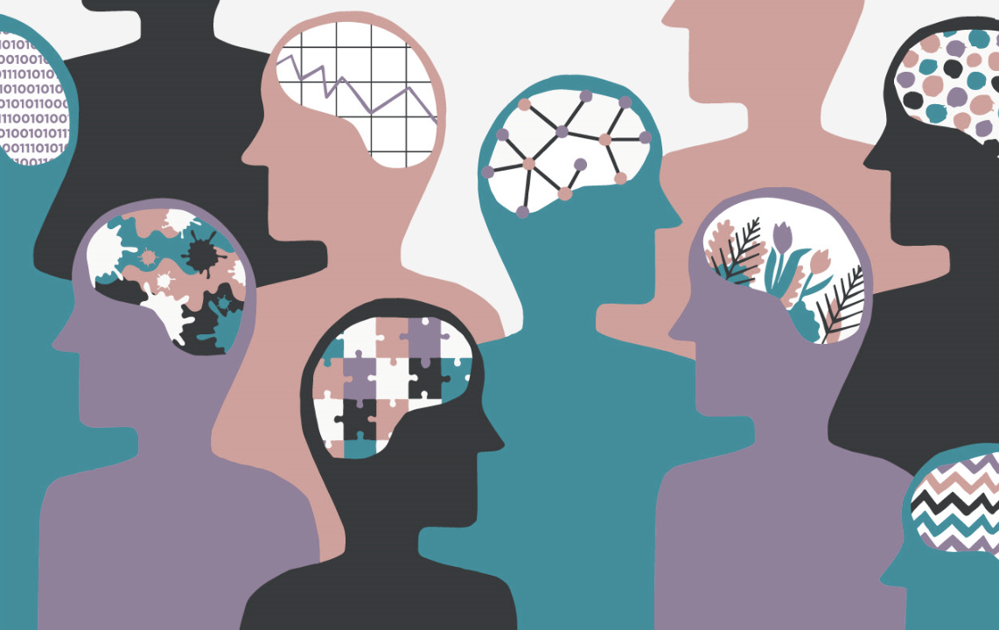

Neurodiversity Awareness
Lunch & Learn
Session 1: Understanding Neurodiversity
Health & Wellbeing EDI Network, The Growth Company
November 9th, 2021 – Julie Casanova

Slide 2
Session Outline
Presentation (recorded)
Julie Casanova, Safeguarding Lead & EDI Member
Testimony and Exchange (recorded)
Peter Craen, Team Leader at BGH
Julie Casanova
Q&A Forum (not recorded)
Matthew Gale, Compliance Officer & EDI Member
Julie Casanova
Future Events
Lunch & Learn 2: Neurodiversity & Communication
December 2nd, 1pm
Celebration Week: International Day of Disabled People
First week of December
Lunch & Learn 3: Neurodiversity in the Workplace
January 13th, 1pm

Slide 3
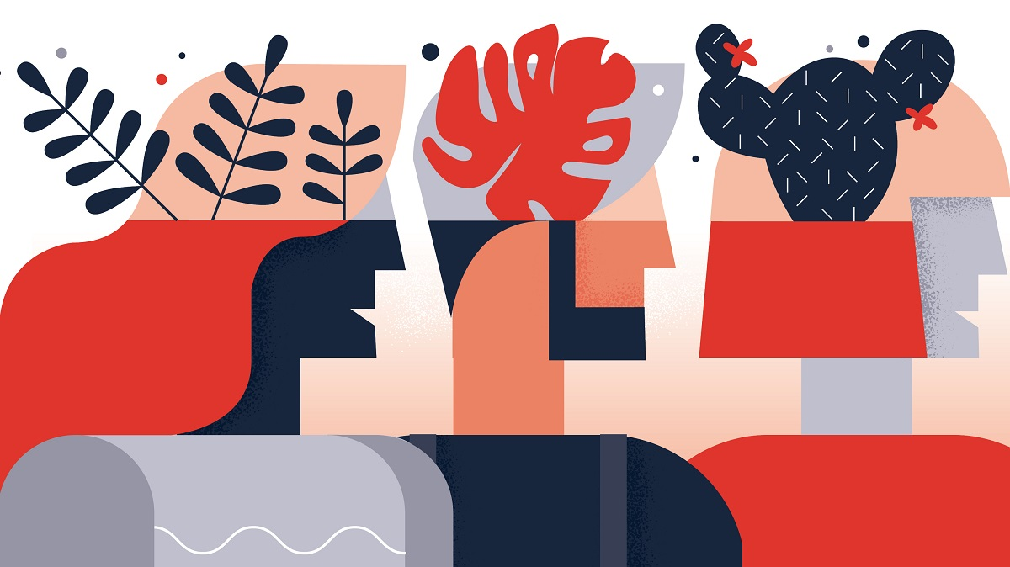

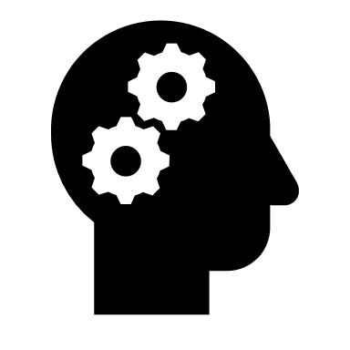


What is Neurodiversity?
Neurodiversity (aka “neurodivergence”) is a positive term coined in the late 1990s to celebrate the diversity inherent in human brains.
It refers to natural variations and differences in the human genome that affect how people…
THINK
PROCESS
LEARN
BEHAVE

Slide 4
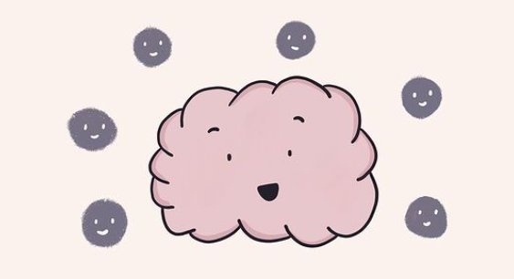
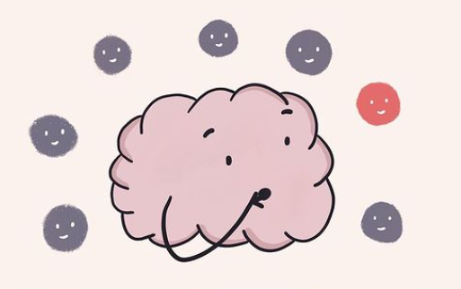
What is Neurodiversity?
Most people are neurotypical, meaning that their brain functions in the way that society expects.
Yet it is estimated that at least 1 in 5 people are neurodiverse and have unique traits, talents and challenges.

Slide 5
What is Neurodiversity?
Brainstorm in the chat!
Neurodiversity encompasses a wide range of conditions.
Examples include:
Dyslexia
Autism
(ASD)
AUTISM
ADHD
Anxiety
Depression
OCD
Dyspraxia
Bipolar
Disorder
Tourette
Syndrome
Down Syndrome
Dyscalculia

Slide 6
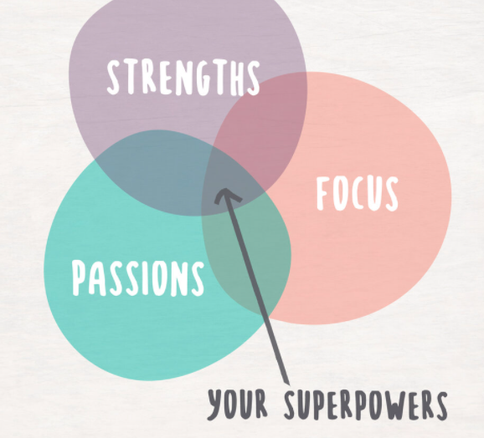
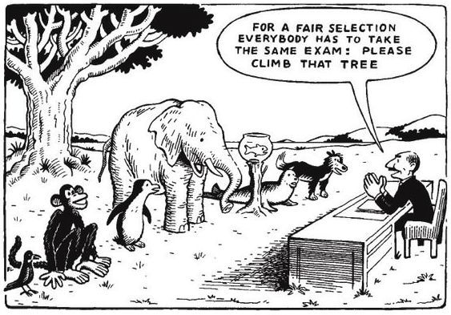
Why is this term important?
Pathologizing differences instead of embracing the vast natural diversity of brains means:
(1) Failing to unleash the potentials of differently-wired brains
“I might be Superman but my planet is Krypton, so I can’t access my superpowers” (Connor DeWolfe, ADHD)

Slide 7
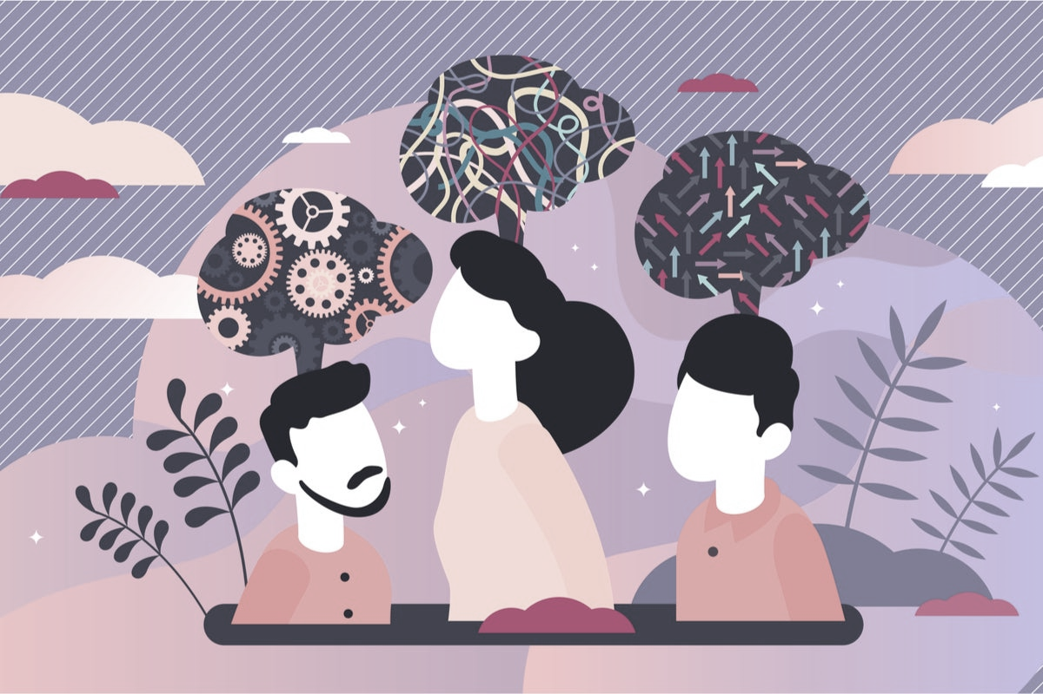
Why is this term important?
(2) Create anxiety-inducing environments with few rewards and high risks for neurodiverse people
  People with ADHD are up to 8 times more likely to attempt suicide;
  People with ASD are up to 10 times more likely to die by suicide;
  Overall, neurodiverse people are at greater risk of depression, experience lower self-esteem, higher levels of loneliness, and are at greater risk of substance misuse and criminal activity.

Slide 8
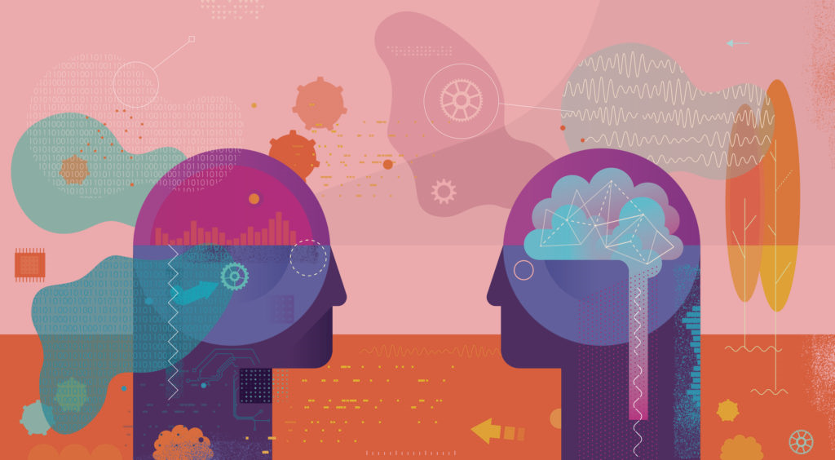
Promoting inclusion
Many challenges faced by neurodiverse people can be overcome with:
Suitable accommodations aka reasonable adjustments
Universal design principles
Letting go of neurotypical standards
Acceptation and respect
Promotion of best practice
Strengths-based approaches

Slide 9
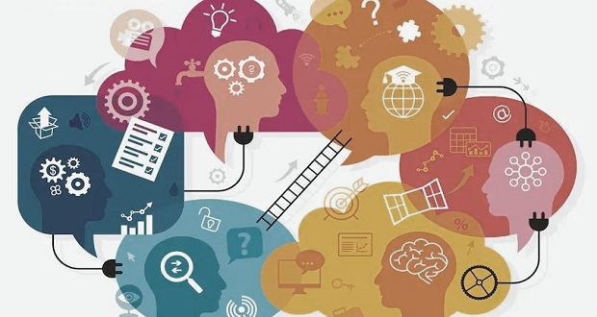
Strengths-based approach
Let’s focus on the strengths/talents inherent to differently-wired brains rather than weaknesses:
Brainstorm
Weaknesses
Strengths
Low regulation of concentration
Prioritisation difficulties
Crippling anxiety
Procrastination
Low frustration threshold
Risk taking
Creativity / originality
Charisma
High levels of energy
Homing attention
(ability to hyper-focus on one thing of great interest)
Roaming attention
(ability to notice many different things in a short period of time)
ADHD

Slide 10
Strengths-based approach
Let’s focus on the strengths/talents inherent to differently-wired brains rather than weaknesses:
Brainstorm
Weaknesses
Strengths
Social difficulties
Communication difficulties
Sensory overload
Resistance to change / very rigid routines
Self-injurious behaviour
High levels of anxiety
Exceptional attention to detail
Alternative approach to problem-solving
Process-driven
Passionate
Honesty / Punctuality
Strong memory
Autism

Slide 11
Strengths-based approach
Let’s focus on the strengths/talents inherent to differently-wired brains rather than weaknesses:
Brainstorm
Weaknesses
Strengths
Difficulties with literacy
Word finding problems
Visual stress
Processing and memory difficulties
Lack of concentration/ distractibility
Creativity
3D thinking
Entrepreneurship
High emotional intelligence
Strong resilience
Ability to absorb some complex information with great ease
Dyslexia

Slide 12
NEURODIVERSITY
QUIZ
Raising Awareness
Challenging Stereotypes

Slide 13
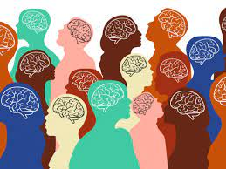
Myth or Fact?
The coexistence of multiple conditions, aka comorbidity, affects a large segment of the neurodiverse population.
For instance, 2/3 of people with ADHD have at least one other condition:
Anxiety (34%)
Depression (29%)
Bipolar Disorder (12%)
Substance Abuse (up to 40%)
Conduct Disorder (up to 43%)
Similarly, research shows that 20% of adults on the autism spectrum also have an anxiety disorder, and that nearly 3% of them have OCD and/or social phobia.
People cannot have more than one neurodiverse condition.

Slide 14

Myth or Fact?
Autistic people may find it harder to read, understand or express emotions. This does not mean that they don’t or cannot empathise with other people. In fact, it is common for autistic people to have hyper-empathy and feel for others very deeply.
“People think autistic people don’t have empathy, but that’s not true. Sometimes I can’t tell if someone’s upset, but, once I know, I feel lots of empathy… maybe even more than neurotypicals.” – Sam in Atypical
“People with Autism do not have empathy.”

Slide 15

Myth or Fact?
People with ADHD have lower levels of dopamine, a neuro-transmitter responsible for motivation, pleasure and rewards. This can lead them to seek instant gratification.
The desire for immediate rewards may distract them from reaching long-term goals, or lead to issues such as debts/addictions.
People with ADHD can overcome these challenges, for instance by:
using visual prompts to remind of goals
exploring triggers/coping mechanisms
developing methods to pause & reflect
working with a life coach
“People with ADHD seek instant gratification.”

Slide 16

Myth or Fact?
Humour, sarcasm and irony can be confusing for autistic people.
This does not mean that an autistic person can’t have a sense of humour of their own or can’t learn to understand conventional humour, sarcasm and irony.
“People with Autism do not have a sense of humour.”
Hannah Gadsby, famous comedian on the autism spectrum

Slide 17
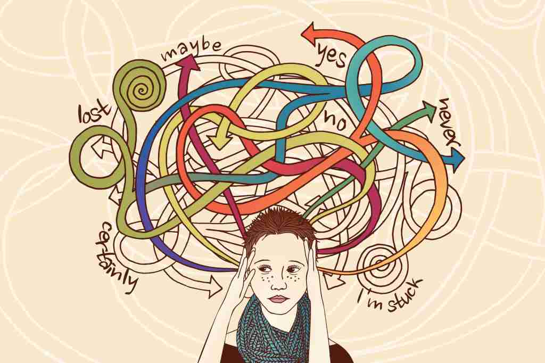
Myth or Fact?
People with ADHD are not lazy. In fact, they tend to be hardworking perfectionists.
ADHD causes executive dysfunction, a state of paralysis that renders starting or finishing a task almost impossible.
This can be caused by overwhelming anxiety, racing thoughts or being fixated on something else (e.g. waiting for an appointment).
“People with ADHD are just lazy.”

Slide 18
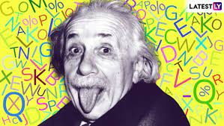
Myth or Fact?
The IQ of neurodiverse individuals vary just as much as that of neurotypicals.
The portrayal of people with ASD in popular culture as either geniuses with a knack for ICT/Maths, or people with severe learning disabilities is misleading and reductive.
Similarly, people with dyslexia are wrongly perceived as being less clever, yet some of the richest and most brilliant CEOs and inventors had dyslexia.
“Neurodiverse people are less clever.”
It is believed that Einstein had both ADHD and dyslexia.

